Slide 1
Evaluation of Photonuclear Cross-Section for Light Nuclei
Ranjeet Dalal
GJUST, Hisar, India-125001
Nuclear Photonics – 2023
Durham, NC, USA

Slide 2
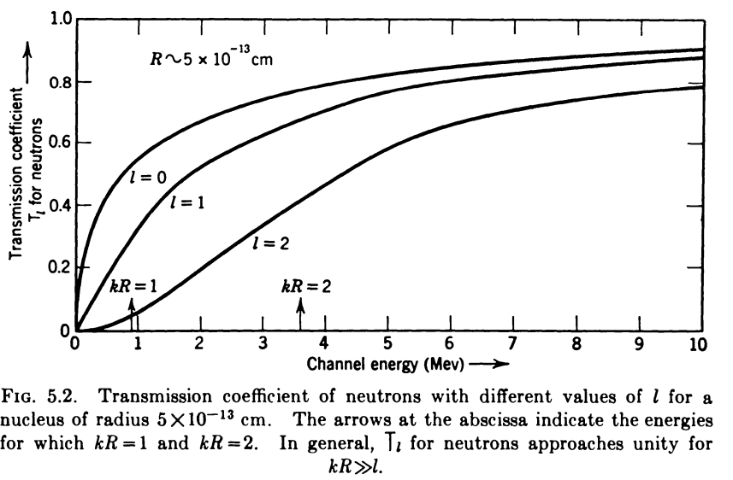
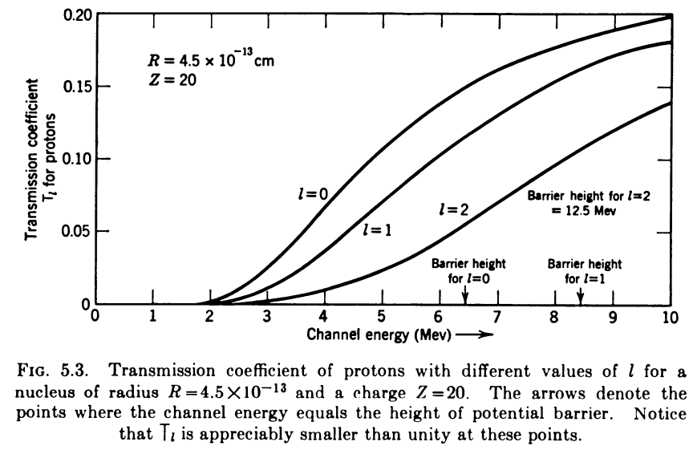
Photonuclear Process - Light vs Heavy Nuclei
In mid-mass and heavy nuclei, we have
Very low Transmission coefficients for charged particles emission in heavier nuclei
- Only few percent of p/d.. are expected to tunnel from coulomb-angular barrier (see figures below)
Significant secondary interactions (charge exchange, excitations…) for outgoing nucleons (from nuclear-interiors)
Phenomenological models tuned for heavy nuclei do not work properly for light nuclei (where these factors are not dominate one)
Fundamentals of Photonuclear process must be established using light nuclei and, then, applied to mid-mass and heavy nuclei.
Blatt and Weisskopf
Ch.-VIII, Sec.-5
Blatt and Weisskopf
Ch.-VIII, Sec.-5

Slide 3
Photonuclear Process in N=Z Light nuclei
In N=Z nuclei, strong interaction is expected between n-p’s occupying similar orbitals
For these nucleons, the n-p interaction is not restricted by Pauli’s principle
The outer positive charge on protons and negative surface charge on neutrons* will enhance their interaction
This leads to strong n-p correlated structures or quasi-deuterons in nuclei (A details account of such 2N structures is given in our recent review article “Nucleon-nucleon correlations inside atomic nuclei: synergies, observations and theoretical models” by R. Dalal and I. J. D. MacGregor, arxiv.org/abs/2210.06114).
These n-p correlated structures or quasi-deuterons are;
Basis of successful Quasi-deuteron model of Levinger
Leads to predominantly, n-p absorption reaction channel for pions in nuclei
Leads to short range correlations (mainly) between neutrons and protons in nuclei
Confirmed by backscattered reactions of energetic hadrons
Confirmed by production mechanism of $p−\overline{p}$ pairs (much lower threshold due to presence of n-p as single entity)
And …
*C. Lorce, Phys. Rev. Lett. 125, 232002 (2020)

Slide 4
For energetic photons interaction with N=Z nuclei, quasi-deuterons would be basic degree of freed freedom
These quasi-deuterons would be paired in their orbitals to form quasi-α structures
N=Z nucleus ≈ [ N (or Z) quasi-deuterons + N/2 quasi-α structures]
The quasi-deuteron photodisintegration cross-section i.e. $σ_{qd}$($γ,np)$ can be estimated using well-established* deuteron photodisintegration relations with appropriate n-p separation energy and size parameter
For free-deuteron, $σ_{ED}$ $\left(γ,np\right)$(in mb) is given by;
$σ_{γ}^{ED}\left(γ,np\right)=\frac{8π}{3}\frac{e^{2}}{ℏc}λ^{−2}{\left(\frac{kλ}{k^{2}+λ^{2}})\right)}^{3}\frac{1}{1−λr_{0t}}×{10}^{4}$ (1)
Where $k=\sqrt{\frac{mc^{2}×(E_{γ}−B.E.)}{{(ℏc)}^{2}}}$, $λ=\sqrt{\frac{mc^{2}×B.E.}{{(ℏc)}^{2}}}$ and $r_{0t}$ is the effective range of triplet state.
The MD contribution to $d(γ,np)$ can be approximated by;
${ σ}_{γ}^{MD}\left(γ,np\right)=\frac{2π}{3}\frac{e^{2}}{ℏc}{\left(\frac{ℏ}{Mc}\right)}^{2}{\left(μ_{n}−μ_{p}\right)}^{2}\frac{kλ{(1−λa_{s})}^{2}}{(k^{2}+λ^{2})(1+k^{2}{a_{s}}^{2})}$ (2)
Where µ_{n} and µ_{p} are magnetic moments of neutron and proton while a_{s} is singlet state scattering length of deuteron.
*H. Arenhovel, and M. Sanzone, Photodisintegration of the deuteron, Springer-Verlag Wien GmbH (1991).

Slide 5
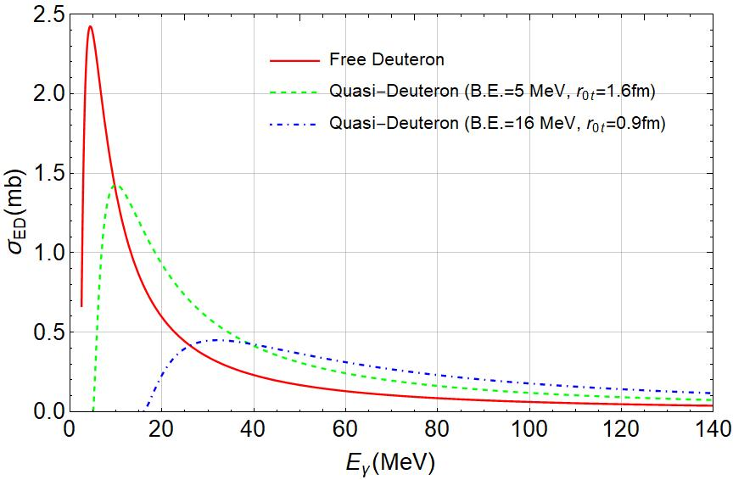
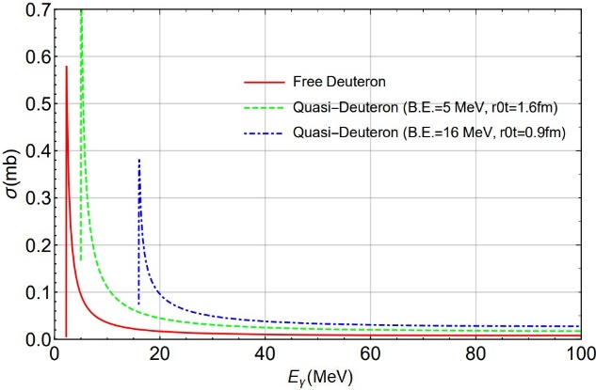
Photo-disintegration of Quasi-deuterons
ED Contribution
MD Contribution
The $r_{0t}$ value is scaled with n-p separation energy.
- The $r_{0t}$=1.75fm is used for free deuteron & $r_{0t}\sim$0.9fm is used for n-p separation energy of ~16 MeV,
- Intermediate $r_{0t}$ values are used for intermediate n-p separation energy
The $σ_{MD}\left(γ,np\right)$ is ~10% of $σ_{total}\left(γ,np\right)$ for $E_{γ}$~100MeV

Slide 6
Photo-disintegration of Quasi-α
The photodisintegration cross-section for channels $\left(γ,n\right) \& \left(γ,p\right)$ for quasi-alpha structures can be computed by Gunn- Irving* approach
Neglecting coulomb interaction of outgoing protons => $σ_{α}\left(γ, n\right)\sim σ_{α}\left(γ,p\right)$
$σ_{α}\left(γ, N\right)$ is sensitive to n/p separation energy and size parameters of ⁴He ($μ_{α}$) and residual ³He/³H ($μ_{T}$/$μ_{3He})$
Properly optimization of size parameters is carried out by comparing the calculated cross-section values with experimental** $σ_{α}\left(γ, N\right)$ values
$σ_{γ,p}=\frac{7×4^{11}π}{3^{9}\sqrt{2}}e^{2} M^{\frac{5}{2}}\frac{μ_{α}^{7}}{μ_{T}^{14}}kE^{\frac{3}{2}} z^{20}{ \{f\left(z\right)\}}^{2}$
Where z and f(z) are defined by; $\frac{1}{z^{2}}=\frac{2ME}{3{μ_{T}}^{2}}+\frac{4{μ_{α}}^{2}}{3{μ_{T}}^{2}}−1$
$f\left(z\right)=\frac{735+346z^{2}}{8}+\frac{21}{1+z^{2}}+\frac{2}{{\left(1+z^{2}\right)}^{2}}−\frac{3\cot^{−1}{z}}{8z}(1155z^{4}+630z^{2}+35)$
*J. C. Gunn, and J. Irving, The photo-electric disintegration of three- and four-particle nuclei, Phil. Mag. 42 1353 (1951).
** Quaglioni S. et al., Two-body photodisintegration of ⁴He with full final state interaction, Phys. Rev. C 69 044002 (2004)

Slide 7
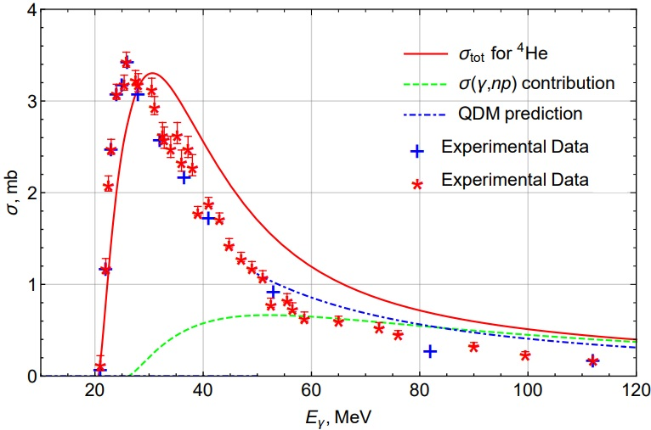
Photo-disintegration of ⁴He
${ σ}_{total}$(⁴He) = $σ\left(γ, n\right)+σ\left(γ, p\right)+{2σ}_{QD}\left(γ, np\right)$
With scale factors ${ μ}_{α}=\frac{1}{1.7}$fm⁻¹, $μ_{t}=\frac{1}{4.5}$fm⁻¹
Quasi-deuteron contribution $(γ, np)$ & Levinger estimate (without damping term) are also shown.
⁴He
$${ σ}_{total}$$
$σ_{qd}(γ, np)$
$σ_{tot}$ vs $E_{γ}$ plot have a prominent peak in GDR region (mainly due to $σ(γ, N)$contribution)
Significant QD contribution inside GDR peak (can be tested by measurements! )
QD contribution dominates for $E_{γ}$>50MeV
The QD contribution is quite similar to Levinger QD model prediction (L= 6.4) for $E_{γ}$>60MeV
Good agreement with measurements
A. V. Varlamov, INDC (NDS) - 394 (Vienna, 1999).

Slide 8
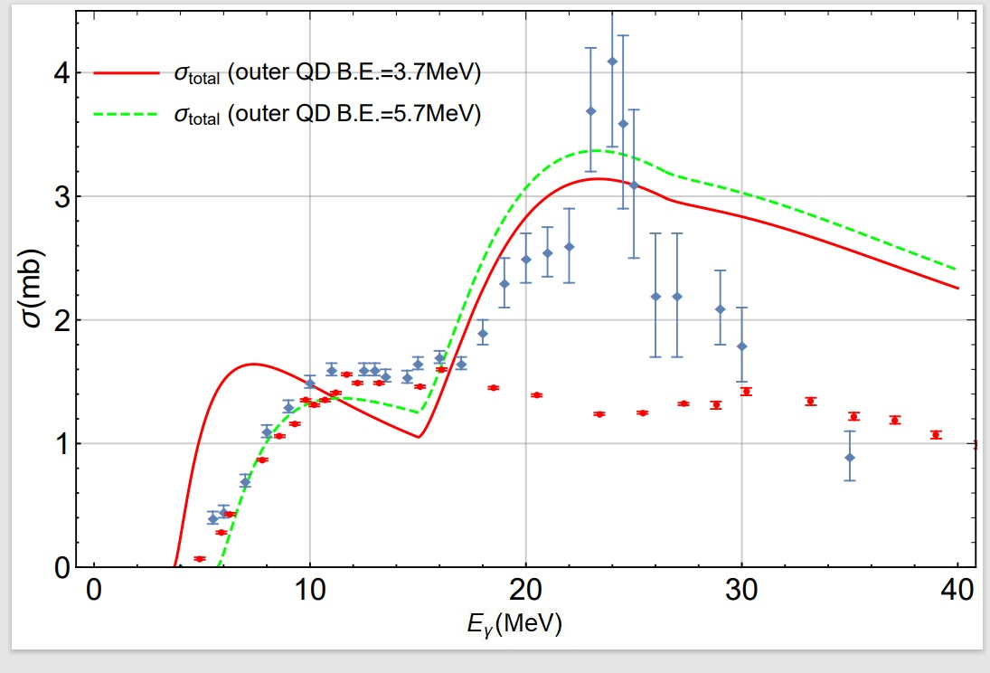
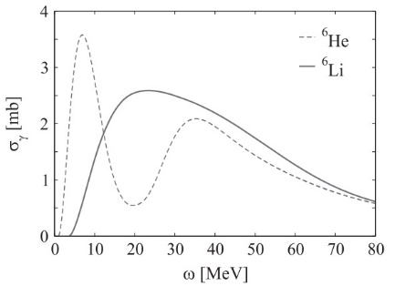
Photo-disintegration of ⁶Li
⁶Li ~ core-α + quasideuteron (loosely bound)
Two np separation energy values for outer QD
3.7 MeV (B.E. of ⁶Li – B.E. of α)
5.7 MeV (~reported effective n-p separation energy for outer quasideuteron)
- Core-α calculation are done similar to ⁴He
- Two peak structure in photonuclear curve!!
2-peak structure observed in measurements** too!!
Sonia Bacca et al
1st peak is due to photodis. of loosely bound outer quasi-deuteron through $(γ, np)$ channel
2nd peak is due to photodis. of core-alpha mainly due to $\left(γ,p\right)+\left(γ,n\right)$ channels
⁶Li double peak structure was not reproduced by recent microscopic ab-initio calculations***
*Varlamov A.V. et al., Atlas of Giant Dipole Resonance IAEA Nuclear Data Section (1999) , ** T. Yamagata et al., Effect of the nuclear medium on α-cluster excitation in ⁶Li, Phys. Rev. C 95, 044307 (2017), ***Bacca S. et al., Electromagnetic reactions on light nuclei J. Phys. G: Nuc. & Part. Phys. 41 123002, (2014)

Slide 9
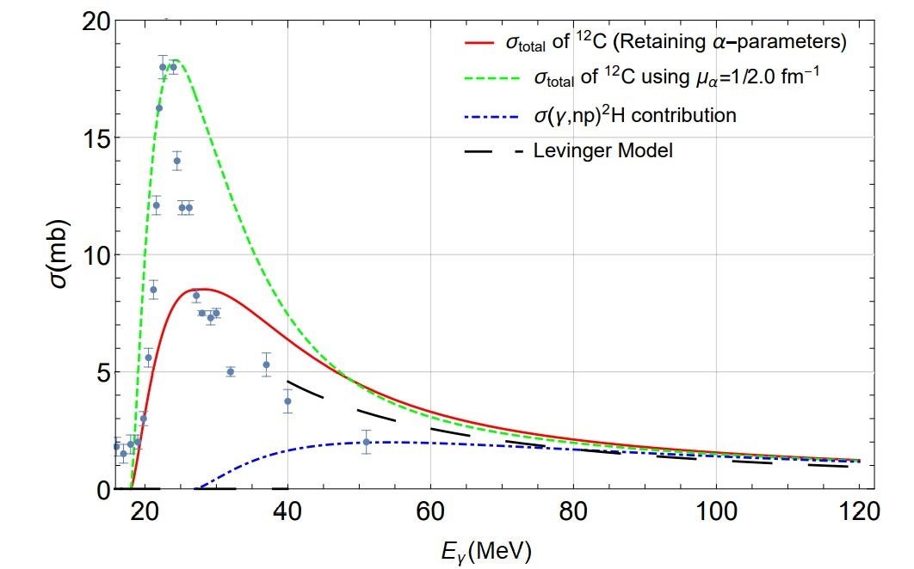
Photonuclear reactions for ¹²C
¹²C
$σ_{total}$ = ${6∗σ}_{qd}\left(γ, np\right)$ + 3*$σ_{quasi−α}\left(γ, N\right)$
Red Curve using the size parameters of free-$α$
The experimental GDR peak can be reproduced using slightly larger size for quasi-alpha structures (Green Curve using $μ_{α}=\frac{1}{2.0}$fm⁻¹) compared to free alpha nucleus.
The GDR peaks due  structures
Quasi-deuteron/np SRC $\left(γ,np\right)$ dominance region
General agreement with measurements*.
Published as
R. Dalal and R. Beniwal, Photo-disintegration of N=Z light nuclei using SRC-based approach, PoS (PANIC2021) 380, 323 (2021).
R. Beniwal and R. Dalal, SRC based model for the photonuclear reactions on N=Z light nuclei, Phy. At. Nucl., Vol. 86, issue 6 (2023)
(paper will be uploaded with ppt on indigo)

Slide 10
Photonuclear reaction for N≠Z nuclei
In the quasi-deuteron region
The photonuclear cross-section is insensitive towards the shell structure of nuclei
And, it is dependent on the presence of short-ranged 2N (and possibly 3N) structures.
Now, if one nucleon is added to N=Z nucleus,
The valance nucleon may interact with the outermost quasi-deuteron and would result in the formation of a 3N quasi-tritium/³He structure.
⁶Li + neutron ~ ⁷Li or quasi-tritium + core-α.
⁶Li + proton ~ ⁷Be or quasi-³He + core-α
There are other reasons for using 3N structures for such nuclei
Will be elaborated in future talks/papers

Slide 11
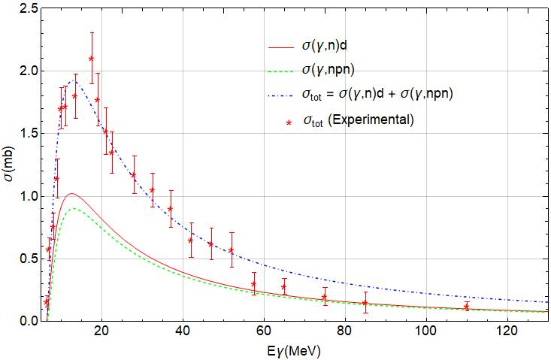
The two- and three-body photo-nuclear cross-section vs $E_{γ}$ plot for ³H.
Proton in ³H is expected to be in a singlet and triplet configurations with two neutrons at a given time
In the case of gamma photon interaction with singlet n-p bond in ³H, it would result in the $(γ,nd)$
In the case of gamma photon interaction with the triplet n-p bond, it will result in a free neutron and n-p structure having singlet unstable bond leading to $\left(γ,nnp\right)$ outcome

Slide 12
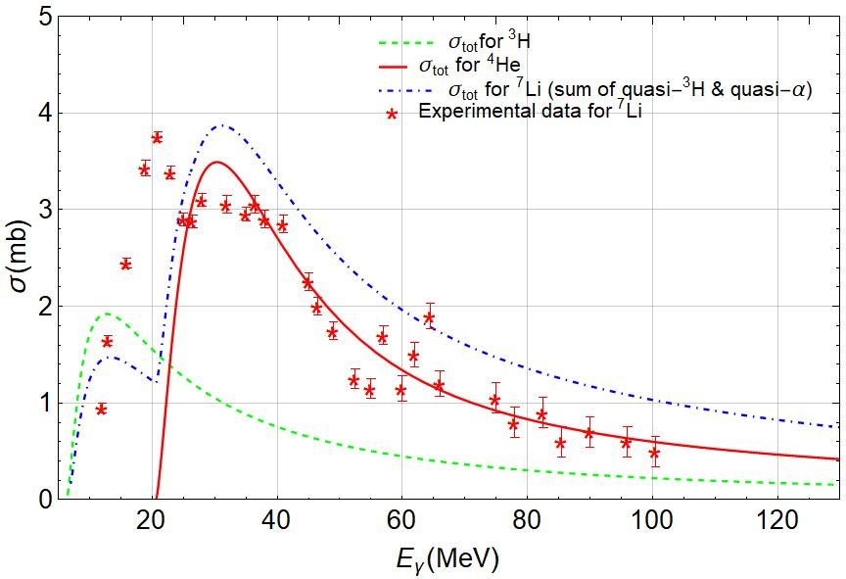
Photonuclear reaction for ⁷Li
Proposed model can be tested by measuring various reaction channels (from outer quasi-tritium and core alpha)
⁷Li$→3H+α$ channel is not included in above plot (will contribute below 20MeV to σ)

Slide 13
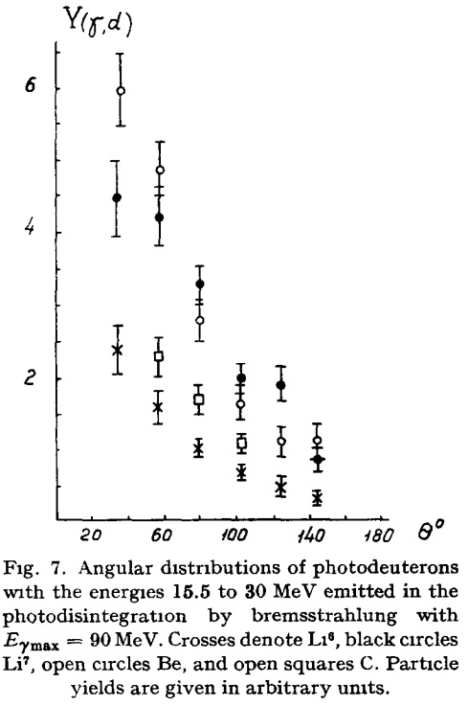
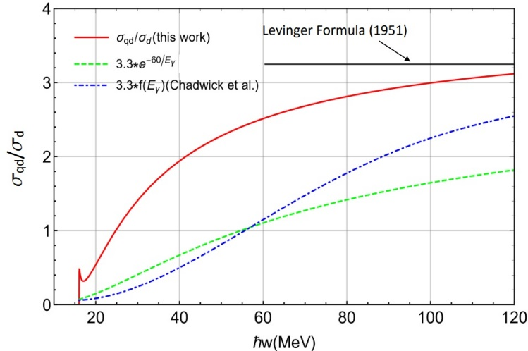
Two possible Test
there are many other interesting implications!
Enhanced deuteron production in photonuclear reaction with N≠Z nuclei due to 3N structures
Kinematic correlation is expected between outgoing ²H and N
(due to 2-body photodisintegration of 3N-structure)
Possible way to confirm presence of 3N structures in nuclei!
Chizhov, Nucl. Phys. 34, 562
⁷Li
There is significant variation in prediction of σ(γ,np) channel in
Present approach (red line)
Levinger original model (straight line)
Levinger model with exponential damping (green line)
Chadwick model (with Pauli-term)
⁶Li
Radio of σ(γ,np) for quasi-deuteron vs that of for free deuteron
For N=Z nuclei

Slide 14
Summary and Future Outlook
$σ_{γ,tot}$= $σ\left(γ,N\right)+ σ(γ,np)$ for N=Z light nuclei is calculated
Assuming neutrons/protons in np SRCs/QD which pair off to form quasi-α structures
Photo-dis. cross section is the sum of individual SRCs/QD and quasi- α photo-dis.
$σ_{tot}$ vs $E_{γ}$ curve for ⁶Li nucleus results in double-peak structure in accordance to the measurements
Direct/Indirect $σ\left(γ,np\right)$ measurements inside and above GDR peaks can used to compare current and older approaches.
Proposed approach is being extended for N$≠$Z nuclei assuming 3N structures.
Possibility of new phenomena like ($γ,Nd)$ photonuclear reactions with kinematic correlations of outgoing N and deuteron
Shell effect, secondary interactions, coulomb and nuclear potential barriers will be implemented in future.
Work in isolation -> Need suggestions/collaborations

Slide 15
Thank you for your attentions !

Slide 16
Additional Slides

Slide 17
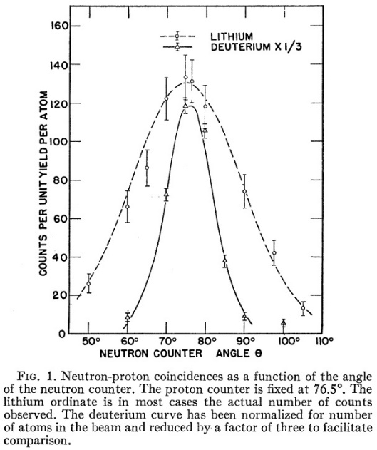
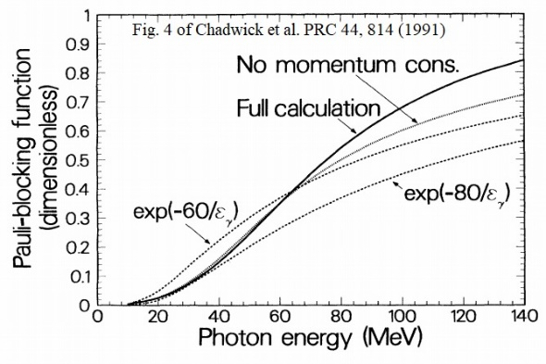
Brief Review of Quasi-deuteron Model
Barton, Phys. Rev. 95, 573
Assuming, N*Z = Possible no of np pairs
with Interaction probability $∝$ $1/{Volume of nucleus}$ = 1/A
Levinger¹ proposed that $σ\left(γ,np\right)$ is
$σ \left(γ, np\right)=L \frac{N Z}{A} σ_{d}$($γ$, np) (1) Where, Levinger constant ~ 4-10
Excellent support from measurements^{2,3,4}
Dominant photo-disintegration mechanism for E >40-50 MeV onward
up to pion threshold energy
Significant contribution even at much higher energy
(for example, ref^{5,6} for E ~600 MeV & 4.5GeV respectively)
Since the observed cross-sections (by direct methods) for lower E side were
significantly lower than Eq. 1
Levinger (1979)⁷ proposed damping term exp(-D/E)
Chadwick et al. (1991) introduced a Pauli-blocking term⁸
Calculated $σ_{qd}(γ,np)$ peaks⁸ ~ 70-80 MeV
$$f(ε_{γ})$$
Very large damping
1. Levinger J. S., Phys. Rev. 84, 43 (1951) 2. McGeorge J. C. et al., Phys. Rev. C 51, 1967 (1995). 3. Odian, A.C. et al., Phys. Rev. 102, 837 (1956). 4. Stein, P.C. et al., Phys. Rev. 119, 348 (1960) 5. Baba K., Nucl. Phys. A 415, 462 6. Alanakyan K. V. et al., Nucl. Phys, A 367, 429 (1981) 7. Levinger, J. S., Phys. Lett. B 82, 181 (1979). 8. Chadwick, M. B. et al., Phys. Rev. C 37, 814 (1991).

Slide 18
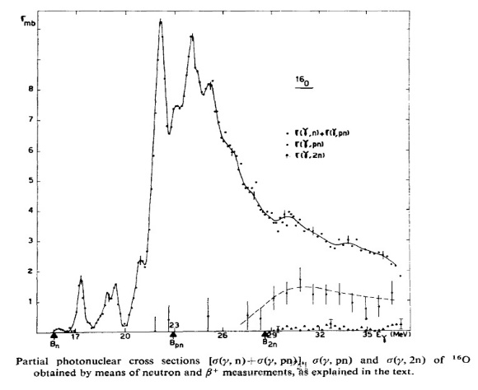
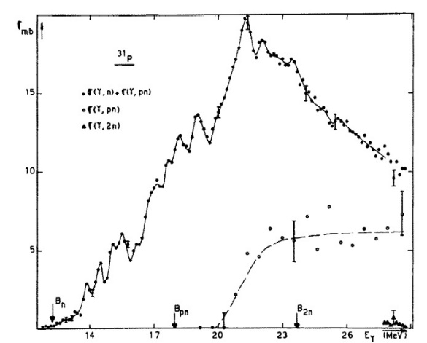
Open Questions with QDM
Phenomenological model, lacking a microscopic origin
Does not fit into usual shell model framework
Can we understand the origin of “L”?
Chadwick & Levinger Damping terms leads to significantly smaller $(γ,np)$ cross-sections for light nuclei
Not supported by indirect (γ,np) measurements
(see left side plots)
How QDM can be used for light nuclei like ⁶Li ?
($γ,n)+(γ,pn)$
¹⁶O
³¹P
($γ,np)$
9. Saclay Group, Nuc. Phys. A221 (1974) 513

Slide 19
n-p SRCs/Quasi-deuterons : An Ubiquitous Phenomena in Nuclei
Photodisintegration by energetic photons (already discussed)
Pion absorption in nuclei is understood through Quasi-free 2N absorption (mostly np SRCs) modelª
Pion absorption proceed mainly through absorption by n-p/quasideuterons
As high as 70% of pion absorption events may be through np-absorption
Direct (Inclusive and exclusive measurements) using few GeV e⁻/p beam^{b,c}
For ejected nucleon momentum > 250MeV/c, ${92}_{−18}^{+8}\%$ of times ejected p⁺ is accompanied with kinematically correlated n ejection
Nucleons in SRCs have high relative momenta and low c.m. momenta
Dominance of n-p SRCs observed (about 94% of all SRCs)
Direct confirmation of quasi-deuteron like structures by (p,pd) reactions since 1960s, see for example see
Sutter^{d} et al. and much recent work at RIKEN^{e}
SRCs are also considered as cause of EMC effect^{b}
Their presence has been recognized through many other type of nuclear reactions
(A comprehensive review of these processes is Nucleon-nucleon correlations inside atomic nuclei: synergies, observations and theoretical models” by R. Dalal and I. J. D. MacGregor, arxiv.org/abs/2210.06114)
ªH. J. Weyer, Pion absorption in light nuclei, Phys. Rep. 195, 295 (1990). ^{b}Hen O. et al., Nucleon-Nucleon Correlations, Short-Lived Excitations, and the Quarks Within Review of Modern Physics 89 045002 ^{c}Piasetzky E. et al., Evidence for Strong Dominance of Proton-Neutron Correlations in Nuclei Phys. Rev. Lett. 97 162504 (2006) ^{d}R. J. Sutter et al., Production of high momentum deuterons from nuclei by 1-BeV protons, Phys. Rev. Lett. 19, 1189 (1967). ^{e}S. Terashima et al., Dominance of tensor correlations (p, pd) reaction, Phys. Rev. Lett. 121, 242501

Slide 20
Model & Photo-disintegration for N=Z nuclei
In N=Z nuclei, n/p are in same orbitals + Opposite Surface Charge Densities for proton & neutron
=> Formation of np SRCs/quasi-deuterons
Major fraction of nuclear B.E. may be contributed by the two-body interaction¹⁰ (IPAM)
These quasi-deuterons would be paired to form quasi-α structures
The photo-disintegration of N=Z nuclei is calculated assuming quasi-deuteron/n-p SRCs and quasi-α degree of freedom
The QD photo-disintegration $σ_{qd}\left(γ, np\right)$ can be inferred from well-known form of $σ_{d} \left(γ, np\right)$ for free deuteron¹¹ using appropriate value of effective n-p separation (B.E.) energy & effective range $r_{0t}$values.
Both ED and MD contributions can be evaluated
- The $r_{0t}$ value is scaled with n-p separation energy of quasi-deuteron
- Tightly bound n-p system would have smaller effective separation
- The $r_{0t}$=1.75fm is used for free deuteron & $r_{0t}\sim$0.8fm is used for n-p separation energy of ~26 MeV
for quasi-deuteron in ⁴He, intermediate $r_{0t}$ values are used for intermediate n-p separation energy
10. Gomes, L. C. et al. Properties of nuclear matter. Ann. Phys. 3, 241 (1958). 11. H. Arenhovel, and M. Sanzone, Photodisintegration of the deuteron, Springer-Verlag Wien GmbH (1991).

Slide 21
Comparison of $σ_{qd\left(γ, pn\right)}/σ_{d\left(γ,pn\right)}$ ratio in different formalisms
For N=Z=A/2 nuclei, the NZ/A factor is equal to Z/2. Levinger formula gives,
$σ_{{}_{Z}^{A}X\left(γ, pn\right)}/σ_{d\left(γ,pn\right)}=L×(\frac{Z}{2})$
Hence, the $σ_{qd\left(γ, pn\right)}/σ_{d\left(γ,pn\right)}$ ratio in that formula is
${ σ}_{qd\left(γ, pn\right)}/σ_{d\left(γ,pn\right)}→L/2$ i.e. ∼3.3 (Black line)
With Levinger Damping term $exp(−D/E_{γ})$ (green)
With Chadwick Pauli-blocking term (blue)
With Current approach (red curve)
(Significant higher $σ_{qd\left(γ, pn\right)}$ is obtained in current approach compared to Chadwick model for lower E)
(np separation energy of 16 MeV)

Slide 22
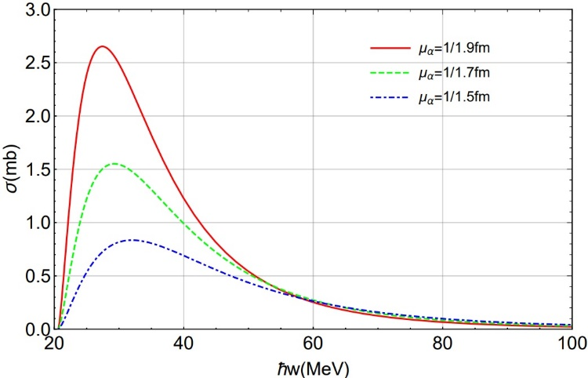
Photo-disintegration of ⁴He & Quasi-alpha
The photodisintegration $σ_{α}\left(γ,n\right) \& σ_{α}\left(γ,p\right)$ can be computed by Gunn- Irving¹² approach using exponential or Gaussian wavefunction for the nucleons
Neglecting coulomb interaction of outgoing protons => $σ_{α}\left(γ, n\right)\sim σ_{α}\left(γ,p\right)$
$σ_{α}\left(γ, N\right)$ is sensitive to n/p separation energy and size parameters of ⁴He and residual ³He/³H
Properly optimization of size parameters is carried out using experimental $σ_{α}\left(γ, N\right)$ values
Quaglioni S. et al., Phys. Rev. C 69 044002 (2004)
$σ\left(γ,N\right)$ variation with ⁴He size parameter
⁴He(γ,n)³He cross section up to 120 MeV
12. J. C. Gunn, and J. Irving, The photo-electric disintegration of three- and four-particle nuclei, Phil. Mag. 42 1353 (1951). 13. Quaglioni S. et al., Two-body photodisintegration of ⁴He with full final state interaction, Phys. Rev. C 69 044002 (2004)

Slide 23
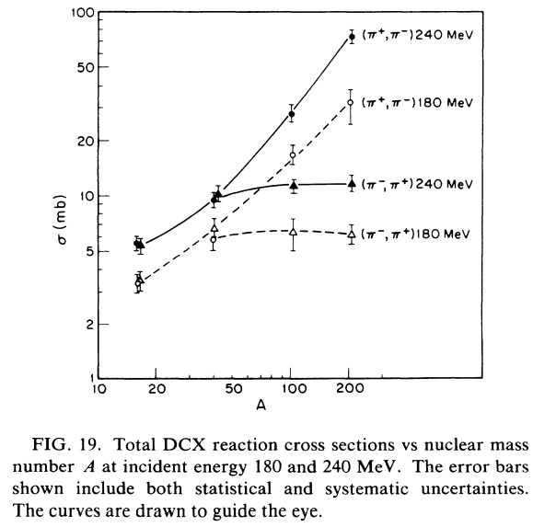
Photo-disintegration of N>Z Nuclei
For N≠Z Nuclei, the extra n/p are assumed to be forming n-p-n/p-n-p or quasi-³H/quasi-3He type 3N structures
Just like np or deuteron system, npn/pnp or ³H/³He systems are found in free state too and do not have any excitation state
Their indirect presence can be observed in
Enhanced deuteron emission for ⁷Li compared to ⁶Li (outer npn can break into n+d)
Strong 3N pion absorption mechanism in ³He involving phase-space of all 3 nucleons
Enhanced double charge exchange reaction ($π^{+},π^{−})$ for N>Z nuclei indication of npn structures
Quenching of $\left(π^{−},π^{+}\right)$Double Charge Exchange (DCX) reactions in neutron rich nuclei. DCX requires the participation of at least two like nucleons whose charges are changed in the process. Since many of the protons are engaged in 3N “npn” structures, they are not available for DCX
Chizhov, Nucl. Phys. 34, 562
⁷Li
⁶Li

