Slide 1
Comparing Fission-Product Yields from Photon-Induced Fission of ²⁴⁰Pu and Neutron-Induced Fission of ²³⁹Pu as a Function of Incident Energy
J.A. Silano, A. Ramirez, R. Malone, A.P. Tonchev, M. Stoyer, R. Henderson, N. Schunck (LLNL)
W. Tornow, C. Howell, F. Krishichayan, S. Finch, (Duke & TUNL), M. Gooden, J. Wilhelmy (LANL)
Nuclear Photonics 2023
September 11-15, 2023, Durham, NC

Slide 2
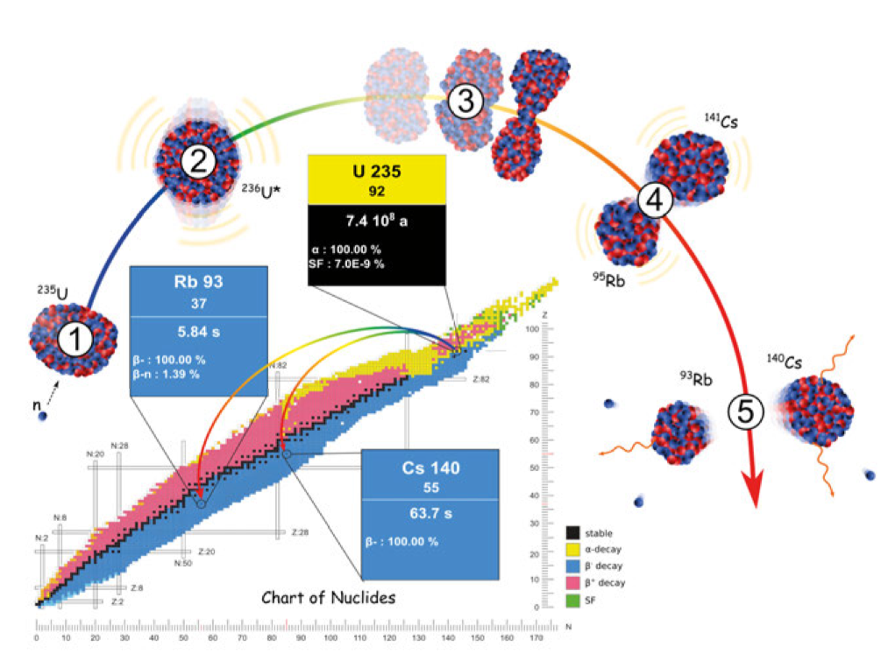
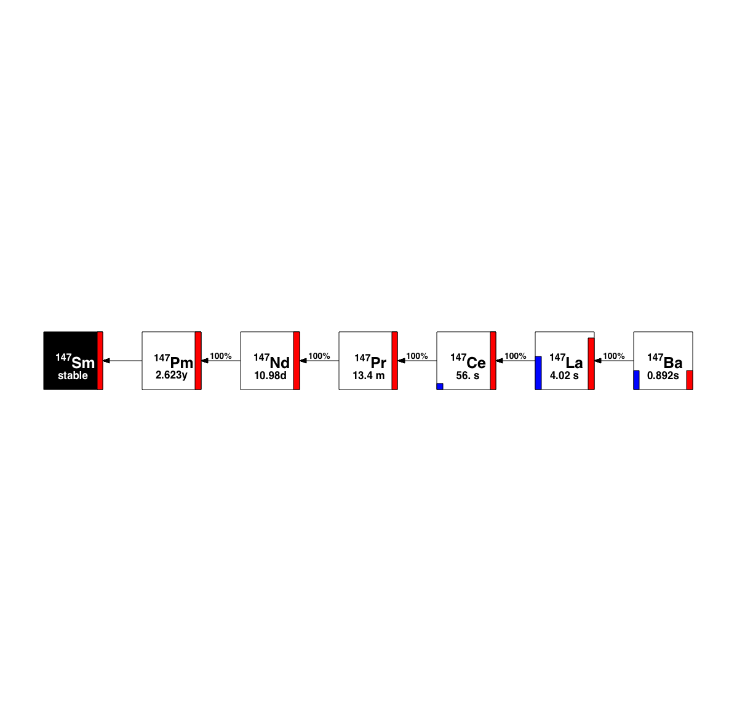
The Nuclear Fission Process
10⁻²¹ s
²⁴⁰Pu*
10⁻²⁰ s
10⁻²² s
¹⁴⁸Ce
²³⁹Pu
10⁻¹⁸-10⁻¹⁰ s
⁹²Kr
γ
⁹⁰Kr
¹⁴⁷Ce
T_{1/2} = 1.8 s
n
γ
n
n
6
γ
T_{1/2} = 56 s
>10⁻³ s
A=147
β⁻
β⁻
β⁻
β⁻
β⁻
β⁻

Slide 3
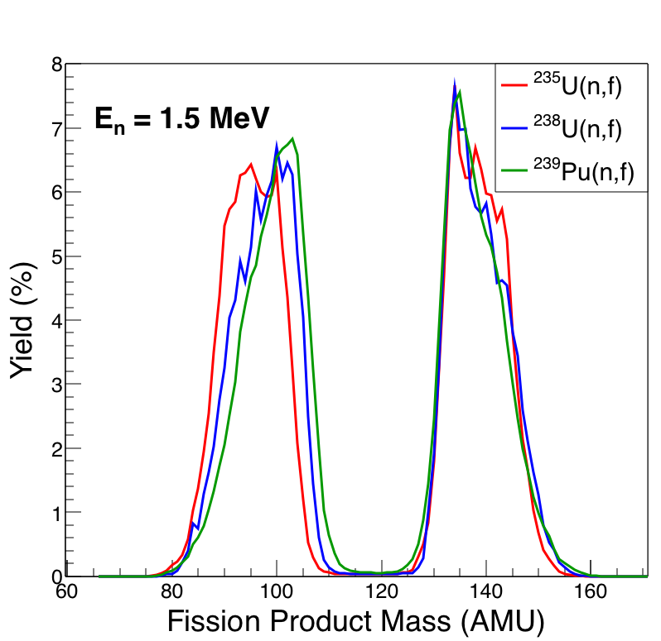
FPY Isotope Dependence
Shape of the FPY mass distribution strongly depends on isotope undergoing fission
Light mass peak shifts to the right with increasing mass of the compound nucleus
Data from T.R. England and B.F. Rider, LA-UR-94-3106 (1994)

Slide 4
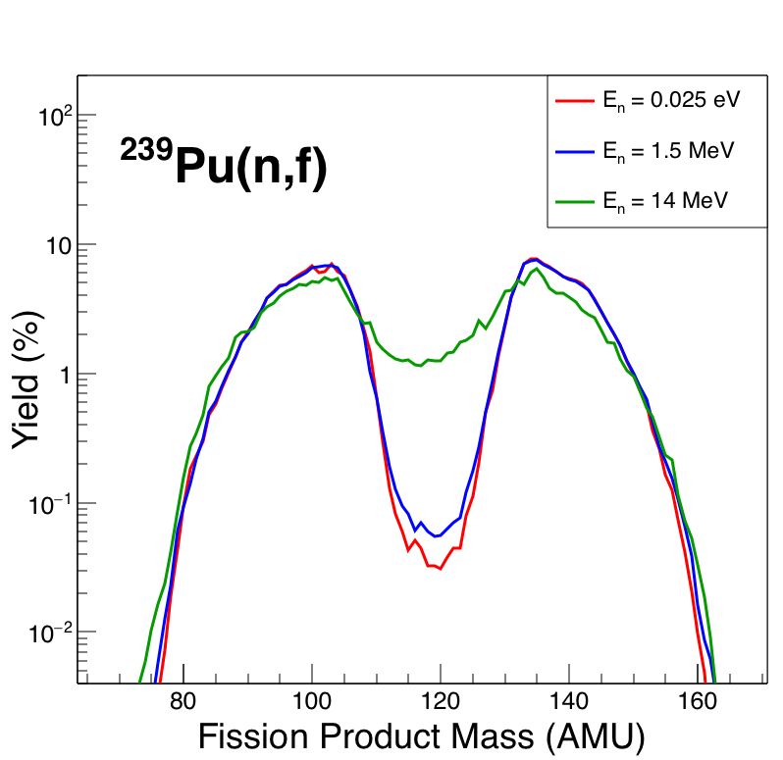
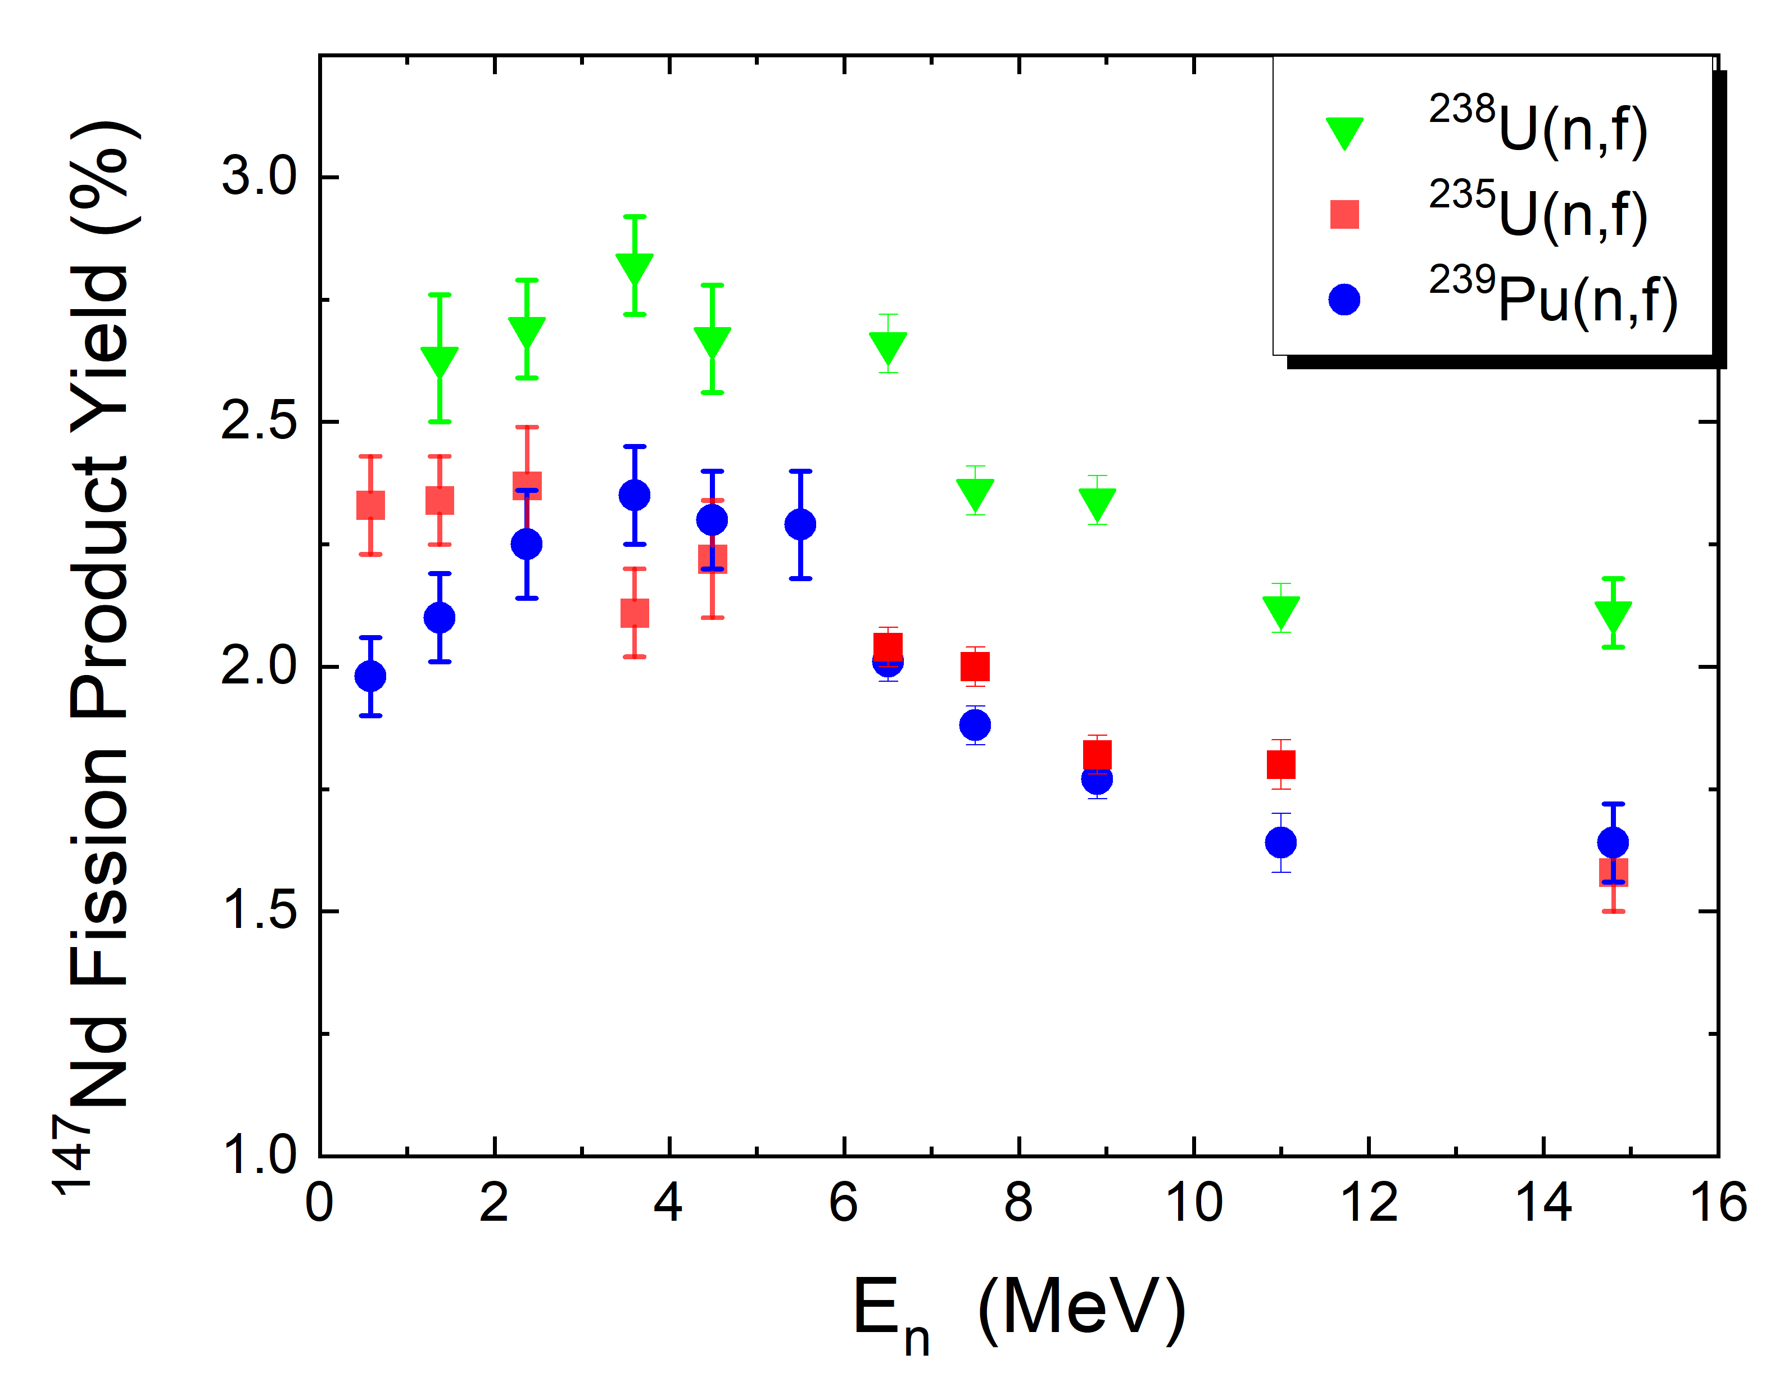
FPY Energy Dependence
Positive trend from 0-4 MeV observed in some high-yield fission products
Needs theoretical explanation
M.E. Gooden et al. In Preparation (2023)
Data from T.R. England and B.F. Rider, LA-UR-94-3106 (1994)

Slide 5
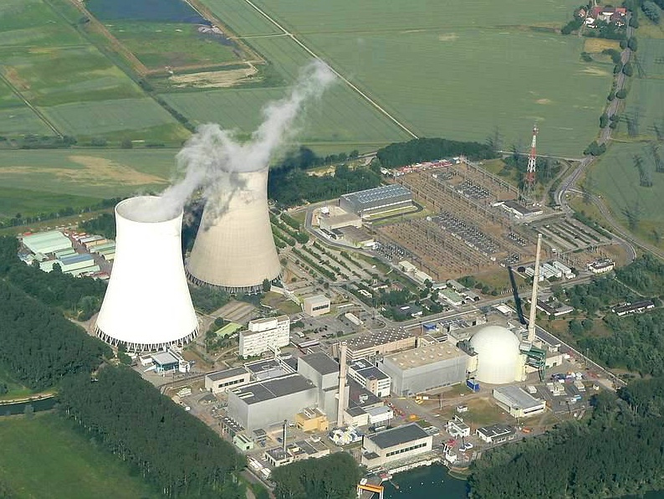
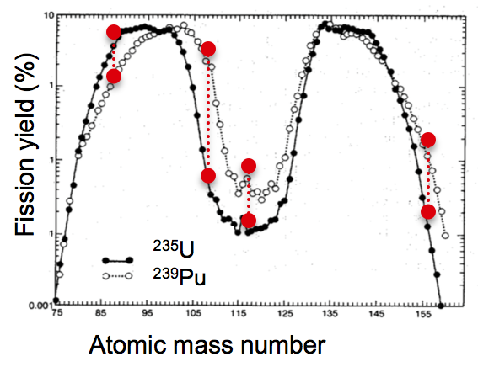

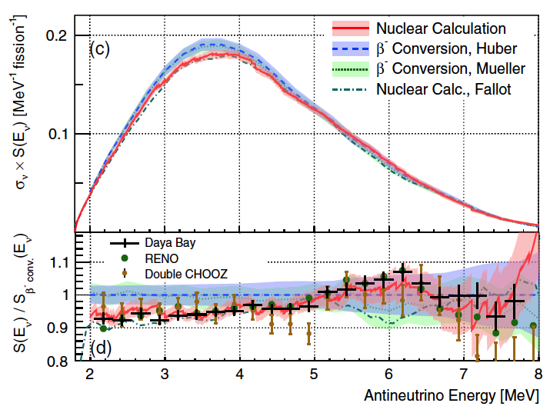
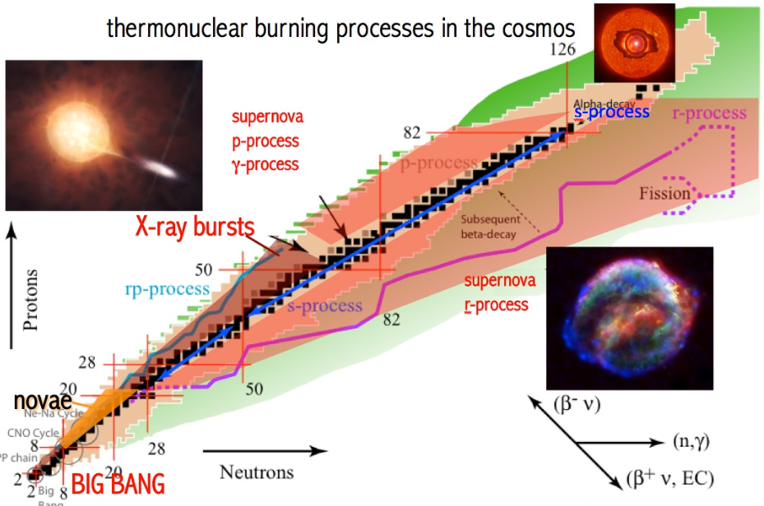
FPY Data Applications
Nuclear Energy
  Independent yields needed for decay heat calculation
Nuclear Forensics
  Cumulative yields provide diagnostic on the type of fissioning material and neutron spectra
Antineutrino Anomaly
  Independent yields from reactor fuel needed to accurately model the antineutrino spectrum
r-process nucleosynthesis
  New FPYs lead to improved predictions of r-process elemental abundance in the universe

Slide 6
The Fission Process – The Bohr Hypothesis
10⁻²¹ s
²⁴⁰Pu*
10⁻²⁰ s
10⁻²² s
¹⁴⁸Ce
²³⁹Pu
10⁻¹⁸-10⁻¹⁰ s
⁹²Kr
γ
⁹⁰Kr
¹⁴⁷Ce
T_{1/2} = 1.8 s
n
γ
n
Bohr Hypothesis: the decay of a compound nucleus for a given E*, J^{π} is independent of how it formed. Step 1 is irrelevant.
n
6
γ
T_{1/2} = 56 s
>10⁻³ s
A=147
β⁻
β⁻
β⁻
β⁻
β⁻
β⁻

Slide 7
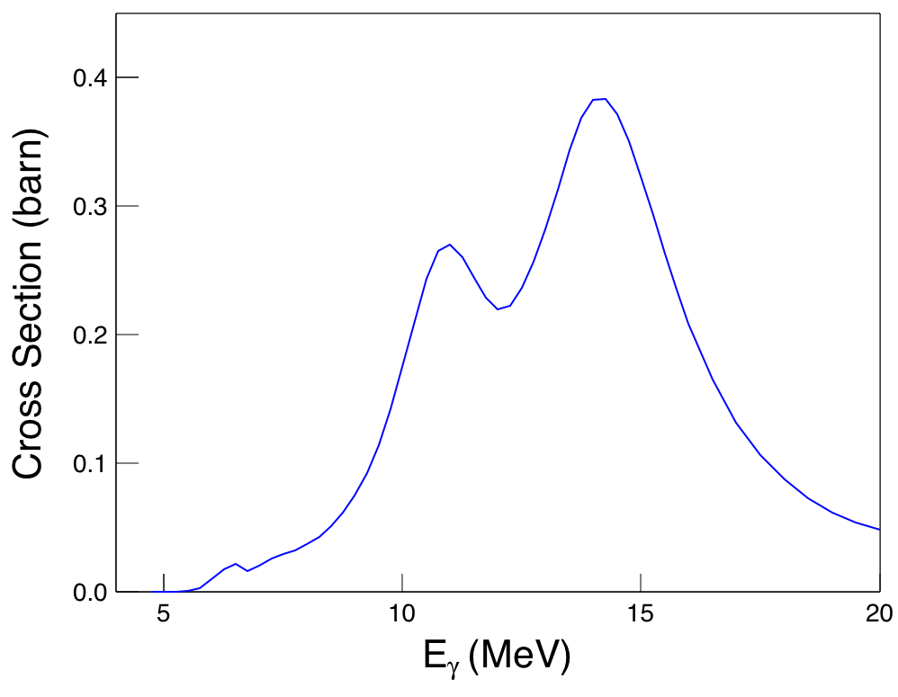
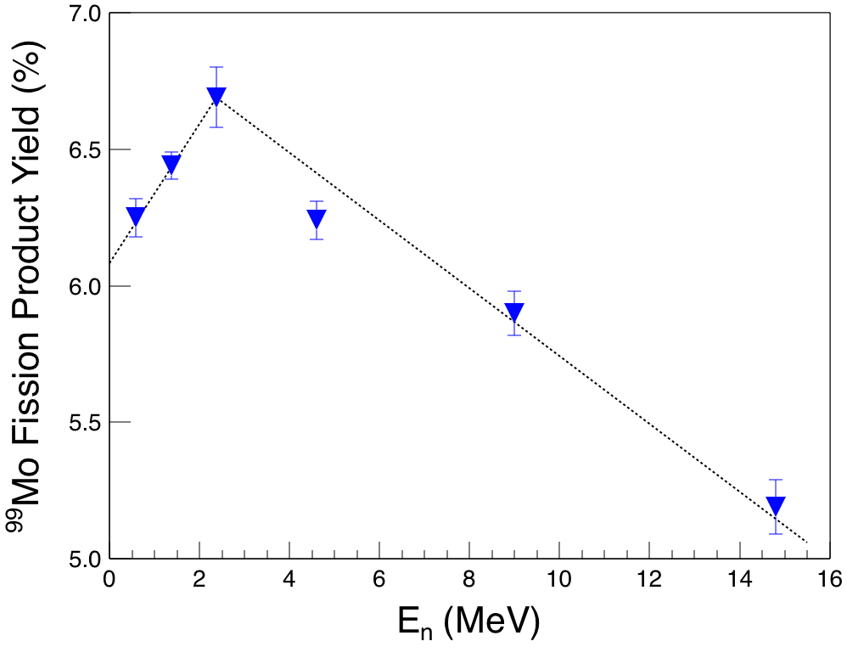
Bohr Hypothesis Test - Photofission of ²⁴⁰Pu
²³⁹Pu(n,f) and ²⁴⁰Pu(γ,f)
  Same compound nucleus:^{240*}Pu
  Match excitation energies
²⁴⁰Pu(γ,f) with HIγS γ-ray beams
²⁴⁰Pu(γ,f)
HIγS
11.2 MeV
15.6 MeV
8 MeV
²³⁹Pu(n,f)
TUNL
1.4 MeV
4.6 MeV
9 MeV

Slide 8

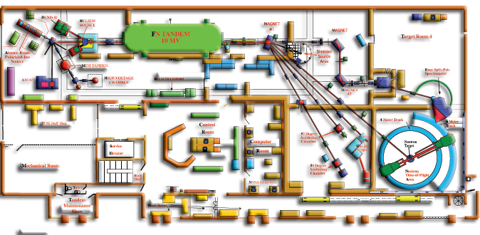
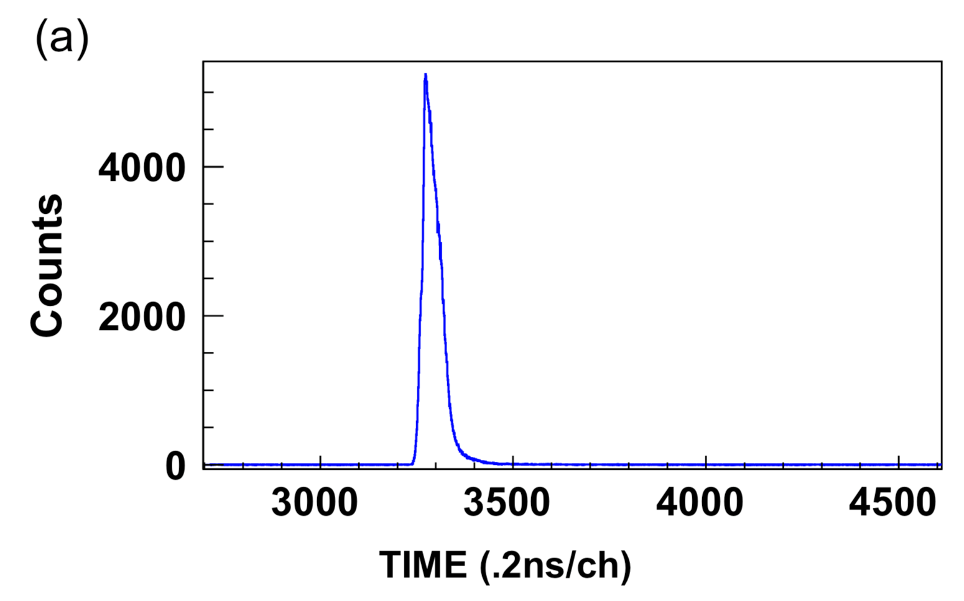
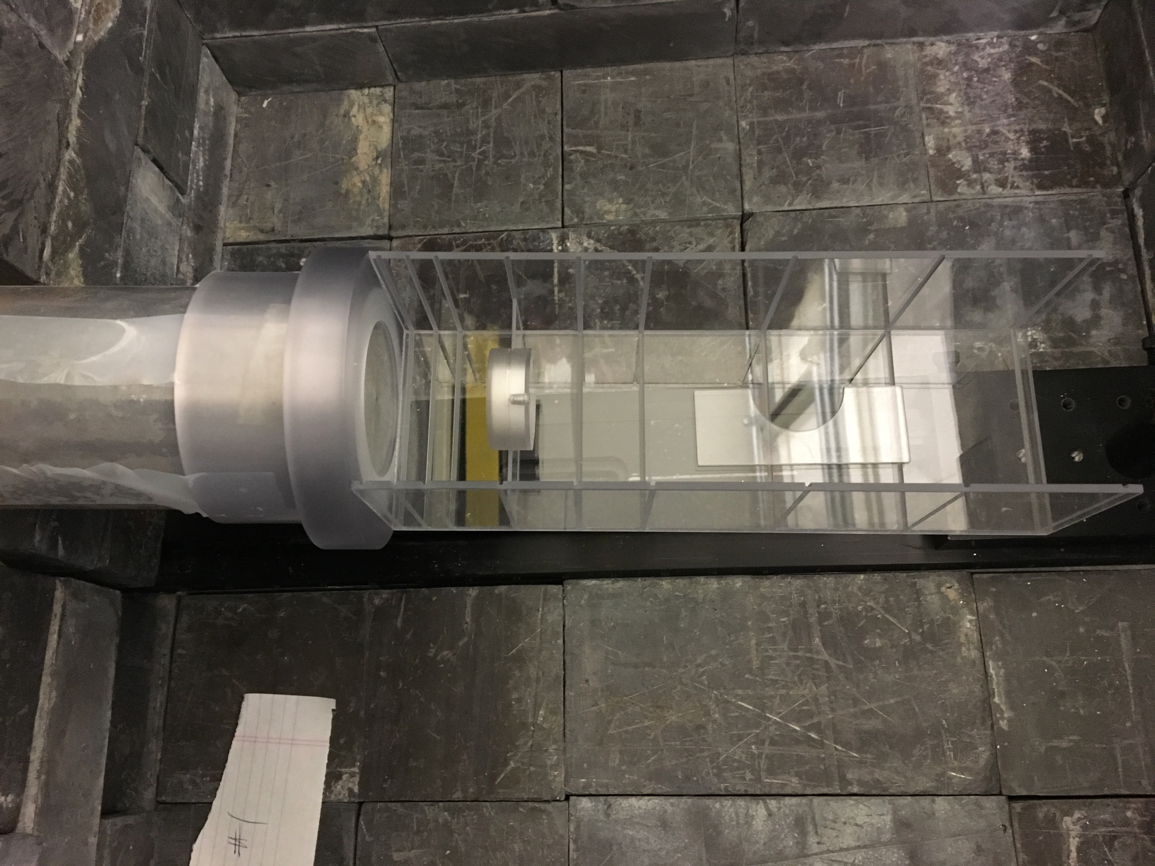
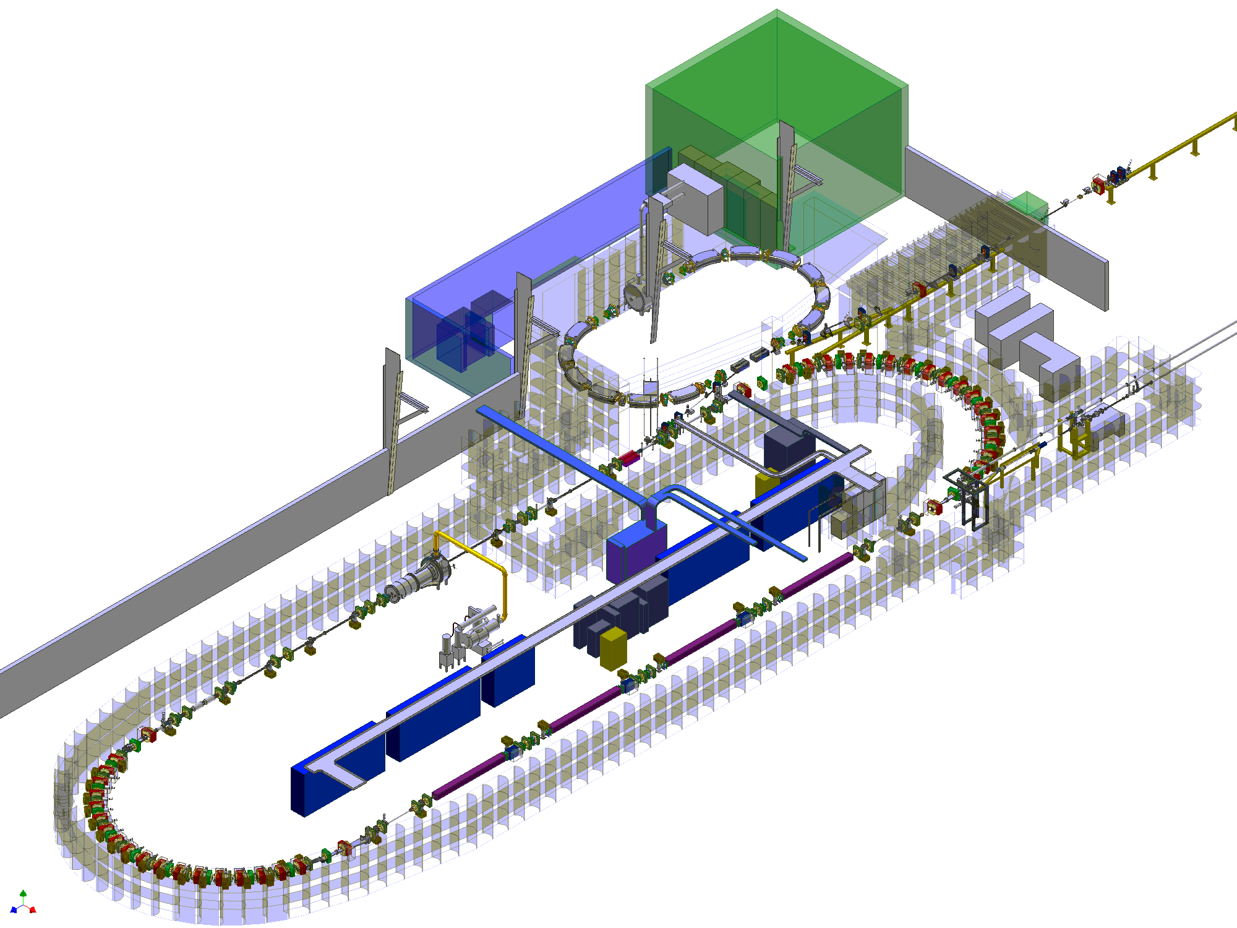
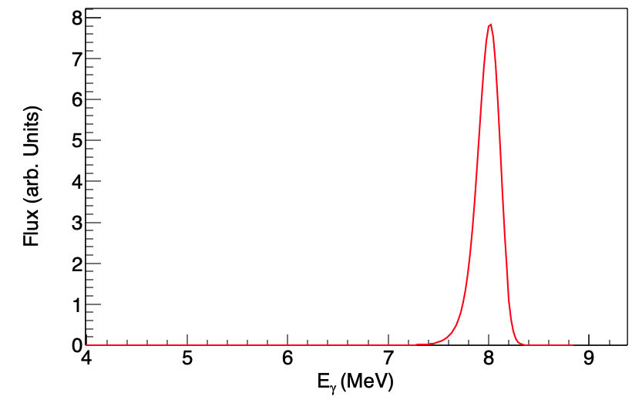
Unique TUNL Capability: Monoenergetic n, γ-ray Beams
FN Tandem van de Graaff
²³⁹Pu(n,f)²⁴⁰Pu*
E_{n}= 1.4 MeV
ΔE= 0.12 MeV
Low background counting facility
HIγS
²⁴⁰Pu(γ,f)²⁴⁰Pu*
E_{γ}= 8 MeV
ΔE= 0.24 MeV

Slide 9
FPY Measurements at HIγS

Slide 10
FPY Measurements at HIγS

Slide 11
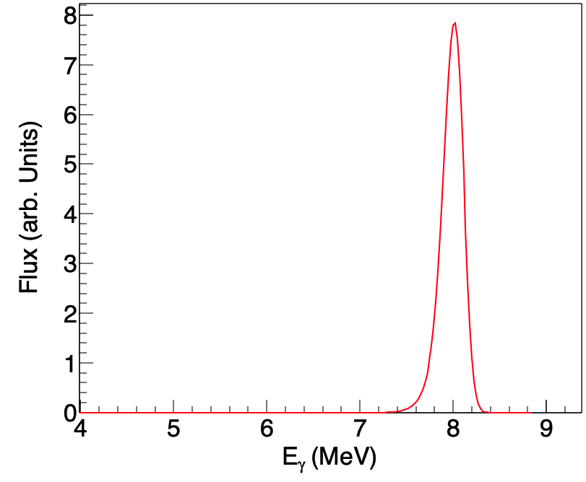
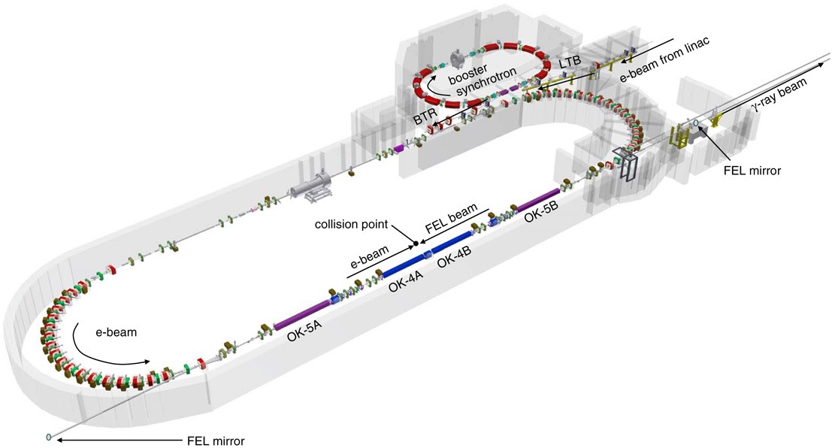
HIγS γ-ray Beams
γ-ray Beam Spectrum
Beam energy: 8 MeV
Energy spread: 240 keV FWHM (3%)
Flux on target: 5.3 x 10⁸ γ/s
8 MeV
FWHM=0.24 MeV
H.R. Weller et al. Prog. Part. Nucl. Phys. 62, 257–303 (2009)

Slide 12
FPY Measurements at HIγS

Slide 13
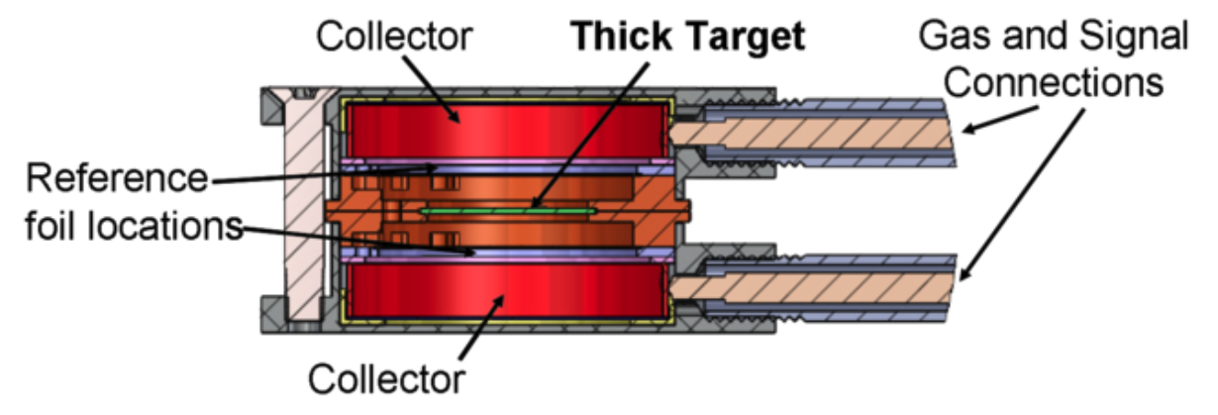
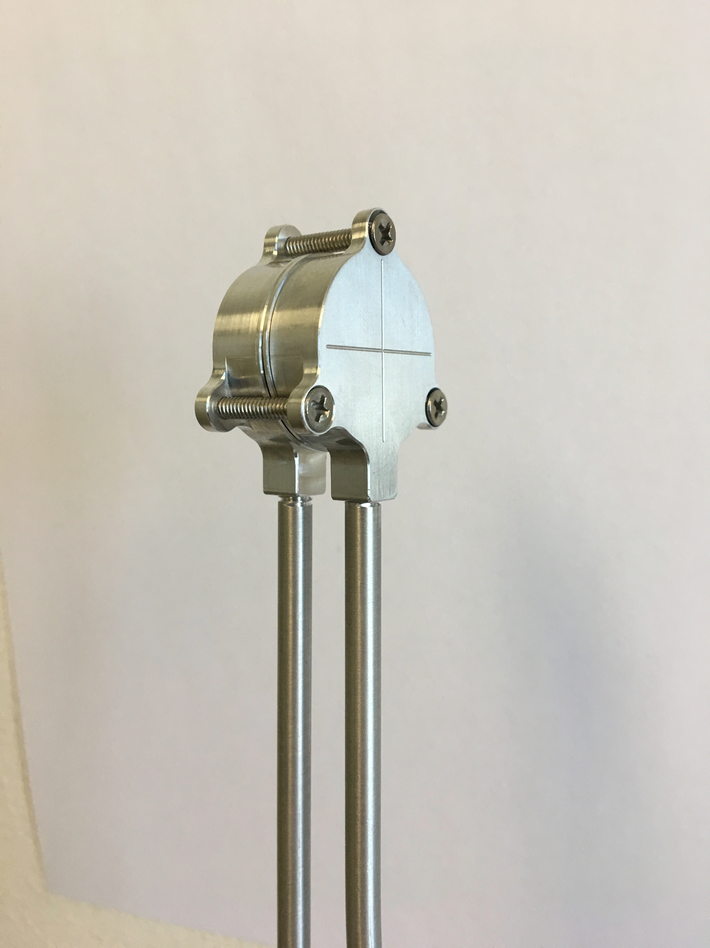
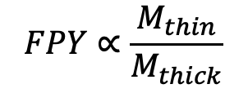

Dual Fission Chamber
Precise fission counting
Eliminates the need for knowledge of beam flux and fission cross section
FC efficiency = 100%
Thin reference foils (~10 µg)
2.54 cm OD
$$FPY∝\frac{1}{σ(γ,f)φ_{γ}}$$
$$FPY∝\frac{M_{thin}}{M_{thick}}$$
Thick activation target (~100 mg)
C. Bhatia et al. Nucl. Instr. Meth. A 757, 7, (2014)

Slide 14
FPY Measurements at HIγS

Slide 15
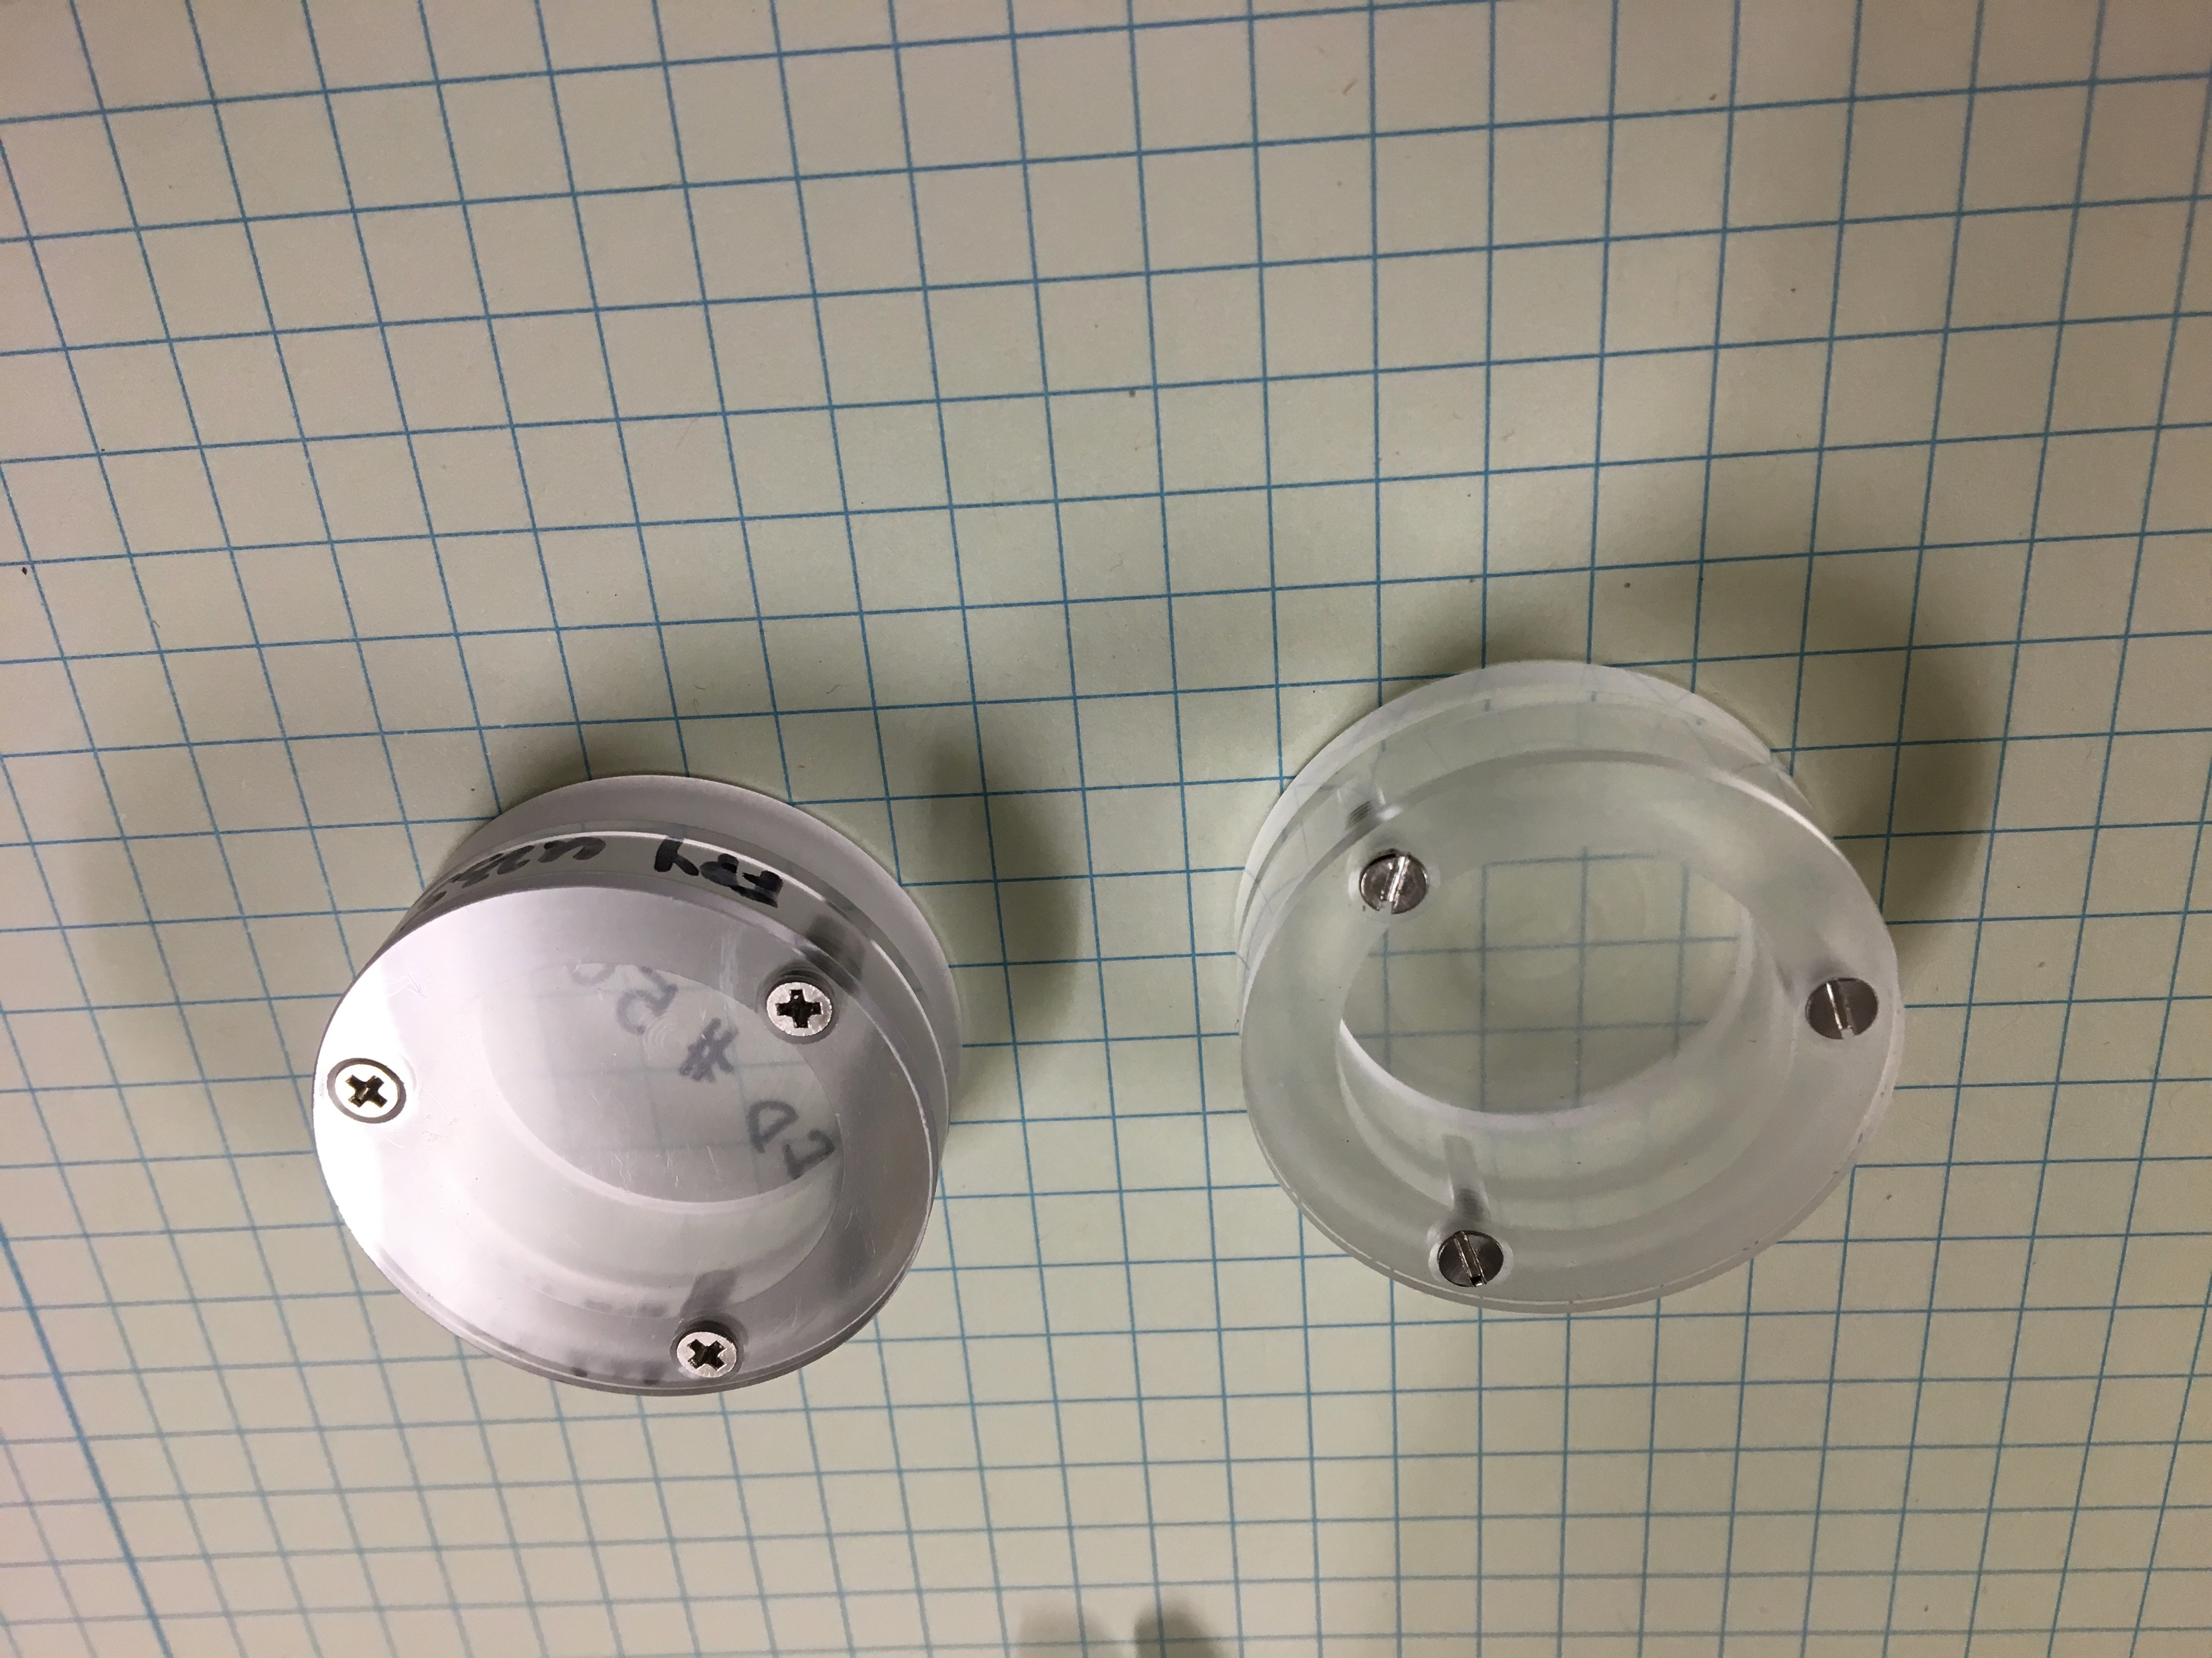
γ-ray Counting
Same 60% HPGe used for ²³⁹Pu(n,f) and ²⁴⁰Pu(γ,f) FPYs
  Identical target holders
  Identical position on HPGe
Spectra recorded in intervals
  5 mins for 1 day
  30 mins for 2 days
  2 hours for 1 week
  Etc…

Slide 16
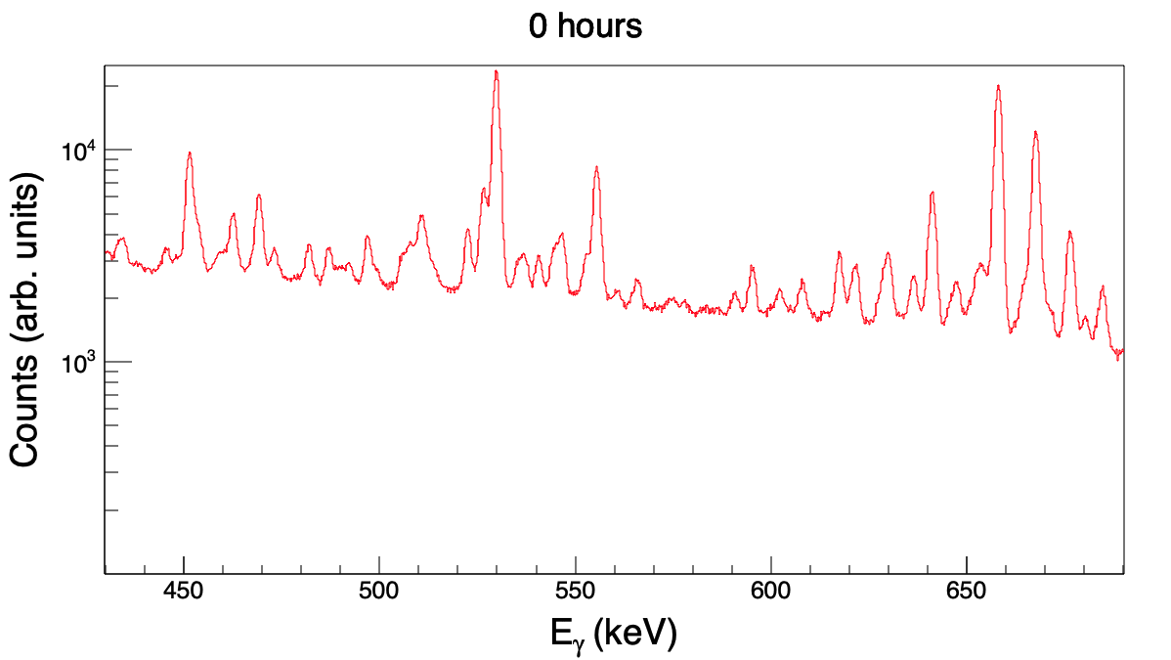
Fission Product Gamma-ray Spectra
¹⁴⁷Nd
¹⁴⁰Ba
T_{1/2}=264 hrs
T_{1/2}=306 hrs

Slide 17
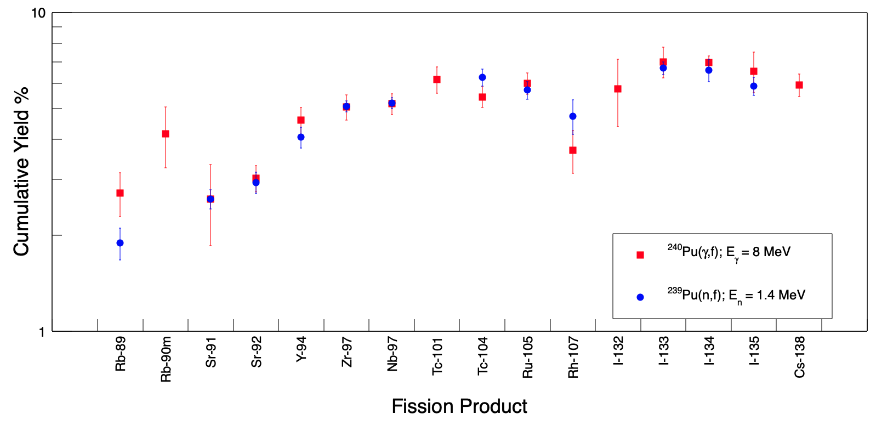
²⁴⁰Pu(γ,f) Results at E_{γ}=8 MeV – 16 Unique FPYs
preliminary

Slide 18
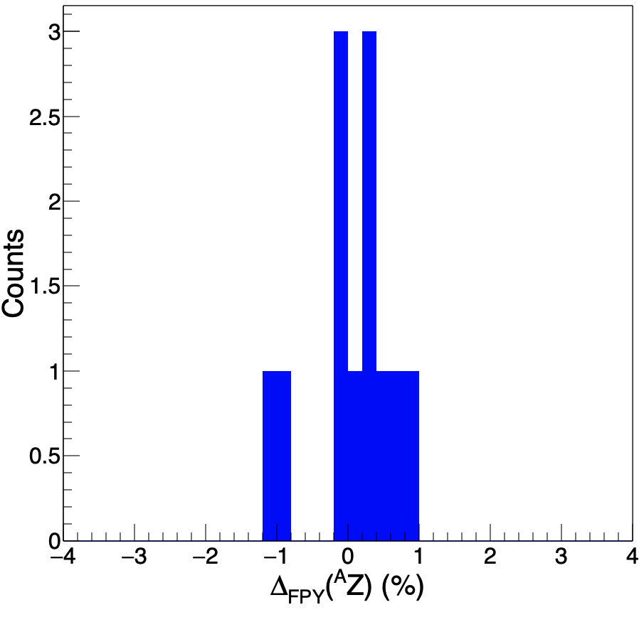

Comparing FPYs from ²⁴⁰Pu(γ,f) and ²³⁹Pu(n,f)
Mean = 0.10%
RMS = 0.53 %
12 unique FPYs present in both data sets
Compare FPYs to probe similarity between reactions
$Δ_{FPY}({}_{ }^{A}Z){=Y}_{{{}_{ }^{240}{Pu(γ,f)}}_{ }}({}_{ }^{A}Z)$ - $Y_{{{}_{ }^{239}{Pu(n,f)}}_{ }}({}_{ }^{A}Z$)
𝛘²/d.o.f. = 0.74

Slide 19
²⁴⁰Pu(γ,f) Results at E_{γ}=11.2 MeV – 38 Unique FPYs
²³⁹Pu(n,f) FPYs supplemented with data from M.E. Gooden et al. Nucl. Data Sheets 131, 319 (2016)

Slide 20
Comparing FPYs from ²⁴⁰Pu(γ,f) and ²³⁹Pu(n,f)
Mean = -0.14 %
RMS = 0.46 %
31 unique FPYs present in both data sets
Compare FPYs to probe similarity between reactions
$Δ_{FPY}({}_{ }^{A}Z){=Y}_{{{}_{ }^{240}{Pu(γ,f)}}_{ }}({}_{ }^{A}Z)$ - $Y_{{{}_{ }^{239}{Pu(n,f)}}_{ }}({}_{ }^{A}Z$)
𝛘²/d.o.f. = 2.51

Slide 21
Comparing ²⁴⁰Pu(γ,f) FPYs at E_{γ}=11.2 MeV to Other Compound Nuclei*
*Gooden et al. Nucl. Data Sheets 131, 319-356 (2016)
²³⁹Pu
²³⁹Pu(n,f) at E_{n}=4.6 MeV is the best fit!

Slide 22
Comparing ²⁴⁰Pu(γ,f) FPYs at E_{γ}=11.2 MeV to Other Compound Nuclei*
*Gooden et al. Nucl. Data Sheets 131, 319-356 (2016)
²³⁹Pu
²³⁵U
²³⁸U
²³⁹Pu
²³⁹Pu(n,f) at E_{n}=4.6 MeV is the best fit!

Slide 23
Conclusions and Future Work
First FPY measurement on ²⁴⁰Pu completed at E_{γ}=8, 11.2 MeV
Preliminary results consistent with Bohr hypothesis
  Validate ^{A}X(γ,f) as surrogate for ^{A-1}X(n,f)
Future ²⁴⁰Pu(γ,f) FPY measurements at additional E_{γ} could further test if energy evolution of yields is consistent with Bohr hypothesis
Validate the Bohr hypothesis on other fission systems (²³⁶U)
Test with alternative fission fragment detection systems (FGIC)

Slide 24
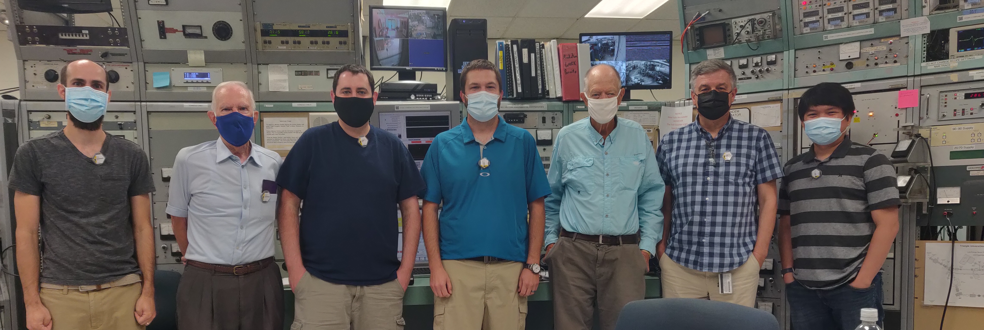
Acknowledgements
C. Hagmann
R. Malone
N. Schunck
A. Tonchev
R. Henderson
A. Ramirez
M. Stoyer
R. Vogt
T. Bredeweg
M. Chadwick
M. Fowler
M. Gooden
T. Kawano
D. Vieira
J. Wilhelmy
S. Finch
C. Howell
F. Krishichayan
W. Tornow

