Slide 1
2D and 3D Imaging by Nuclear Resonance Absorption/Fluorescence Using Extremely Brilliant Compton Sources
Newport Beach
Barty Group Labs
Lumitron Technologies
UCI School of Medicine
Physics & Astronomy
Beckman Laser Institute
Trevor Reutershan and Prof. CPJ Barty
Medical Scientist Training Program (MD/PhD)
Department of Physics and Astronomy
Barty Research Group
Nuclear Photonics 2023 : Durham, North Carolina : September 11th, 2023
Notes:
Dear Audience: If you can see this, then I have done something wrong. Please send help.

Slide 2
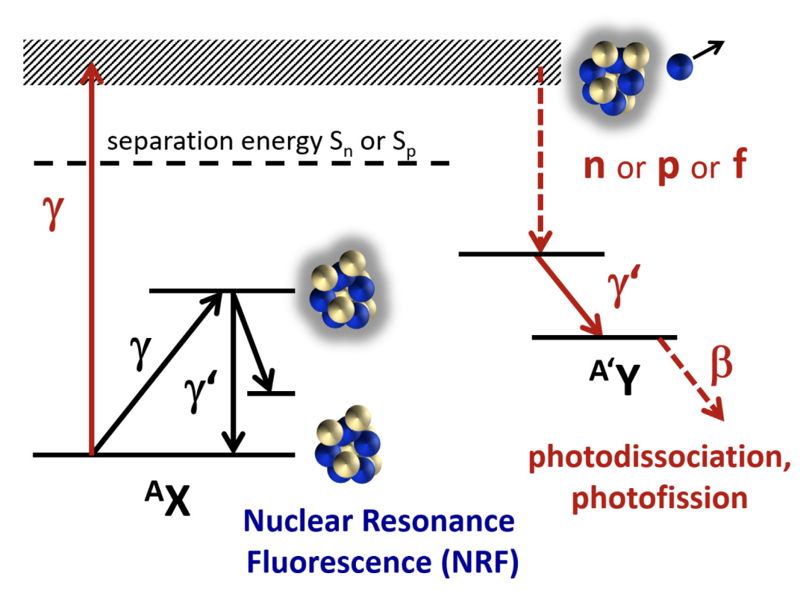
Nuclear Resonance Absorption and Fluorescence
Other interactions include:
Nuclear Thomson/Compton Scattering
Delbrück Scattering
Photon scattering processes with the nucleus
Zilges A, Balabanski DL, Isaak J, Pietralla N. Progress in Particle and Nuclear Physics 122 (2022) 103903

Slide 3
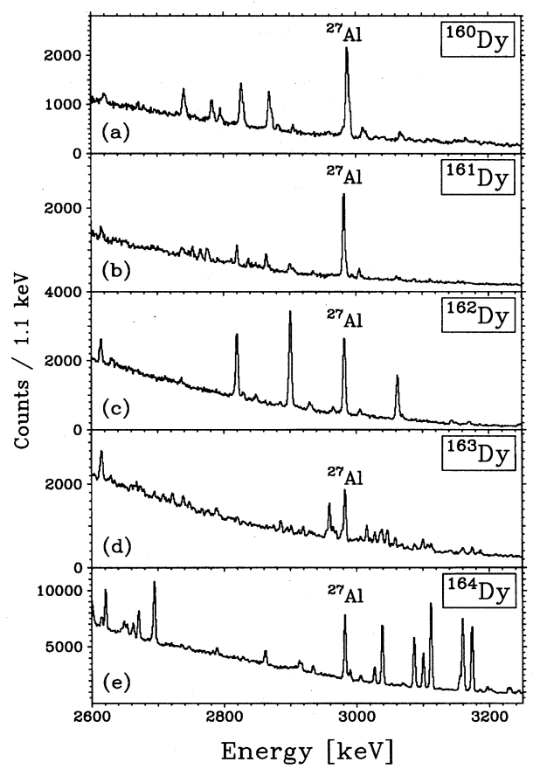
Energy Levels Are Unique to the Isotope
Margraf J, Eckert T, Rittner M, Bauske I, Beck O, Kneissl U, Maser H, Pitz HH, Schiller A, von Brentano P, Fischer R, Herzbert RD, Pietralla N, Zilges A, Friedrichs H. Physical Review C. (1995) 52(5) 2429
Zilges A, Balabanski DL, Isaak J, Pietralla N. Progress in Particle and Nuclear Physics 122 (2022) 103903

Slide 4
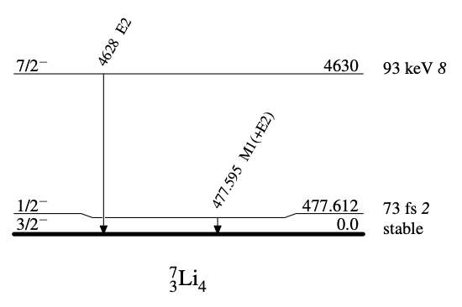
A Narrow Phenomenon…
$$\frac{ΔE}{E}\left( ^{7}\text{Li} \right)=4.69×{10}^{−6}$$
Doppler Broadened
Line widths can be as low as 10⁻⁶ $ΔE/E$
Margraf J, Eckert T, Rittner M, Bauske I, Beck O, Kneissl U, Maser H, Pitz HH, Schiller A, von Brentano P, Fischer R, Herzbert RD, Pietralla N, Zilges A, Friedrichs H. Physical Review C. (1995) 52(5) 2429
National Nuclear Data Center, Brookhaven National Lab, Evaluated Nuclear Structure Data File

Slide 5
How NRF Experiments are Typically Done
1.5 MeV Tungsten Spectrum
Bremsstrahlung
Metal Target
$$e^{−}$$
Filament
$$γ$$

Slide 6
How NRF Experiments are Typically Done
1.5 MeV Tungsten Spectrum
Bremsstrahlung
Fraction of spectrum
$$=1.1×{10}^{−6}$$
Metal Target
$$e^{−}$$
Filament
⁷Li NRF
$$γ$$
Not an ideal source for single resonance line measurements

Slide 7
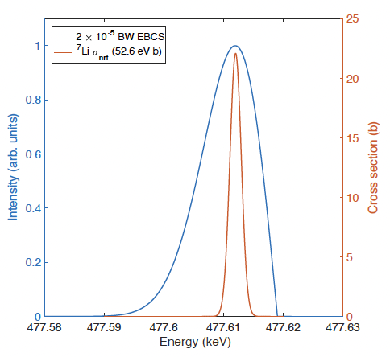
Laser-Compton Scattering has the Edge
Bremsstrahlung
LCS
$$ΔE∼\text{MeV}$$
$$ΔE<\text{keV}$$
⁷Li NRF
Fraction of spectrum
Fraction of spectrum
$$=1.1×{10}^{−6}$$
$$=0.21$$
LCS has narrow bandwidths that make probing these lines much better

Slide 8
Laser-Compton Source
$$E_{γ}=\frac{4γ^{2}}{1+γ^{2}θ^{2}+4γk_{0}λ_{c}}E_{L}$$
Reutershan T, Effarah HH, Lagzda A, Barty CPJ. Applied Optics (2022) 61(6):C162:178

Slide 9
Laser-Compton Source
Double Doppler upshift
$$E_{γ}=\frac{4γ^{2}}{1+γ^{2}θ^{2}+4γk_{0}λ_{c}}E_{L}$$
Reutershan T, Effarah HH, Lagzda A, Barty CPJ. Applied Optics (2022) 61(6):C162:178

Slide 10
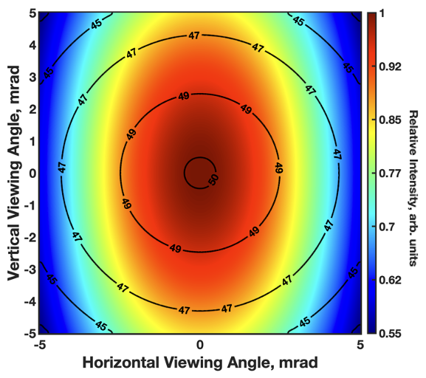
Laser-Compton Source
Double Doppler upshift
$$E_{γ}=\frac{4γ^{2}}{1+γ^{2}θ^{2}+4γk_{0}λ_{c}}E_{L}$$
Angle correlated spectrum
Reutershan T, Effarah HH, Lagzda A, Barty CPJ. Applied Optics (2022) 61(6):C162:178

Slide 11
Laser-Compton Source
Double Doppler upshift
$$\frac{dN}{dΩdω}=∫\frac{dσ}{dΩ}δ\left(ω−ω_{l}\frac{κ_{l}}{κ}\right)\left(1+β_{0}\right)n_{l}(x_{μ})n_{e}(x_{μ})d^{4}x_{μ}$$
$$E_{γ}=\frac{4γ^{2}}{1+γ^{2}θ^{2}+4γk_{0}λ_{c}}E_{L}$$
Angle correlated spectrum
Reutershan T, Effarah HH, Lagzda A, Barty CPJ. Applied Optics (2022) 61(6):C162:178

Slide 12
Laser-Compton Source
Double Doppler upshift
$$\frac{dN}{dΩdω}=∫\frac{dσ}{dΩ}δ\left(ω−ω_{l}\frac{κ_{l}}{κ}\right)\left(1+β_{0}\right)n_{l}(x_{μ})n_{e}(x_{μ})d^{4}x_{μ}$$
$$E_{γ}=\frac{4γ^{2}}{1+γ^{2}θ^{2}+4γk_{0}λ_{c}}E_{L}$$
Angle correlated spectrum
Laser beam properties
Reutershan T, Effarah HH, Lagzda A, Barty CPJ. Applied Optics (2022) 61(6):C162:178

Slide 13
Laser-Compton Source
Double Doppler upshift
$$\frac{dN}{dΩdω}=∫\frac{dσ}{dΩ}δ\left(ω−ω_{l}\frac{κ_{l}}{κ}\right)\left(1+β_{0}\right)n_{l}(x_{μ})n_{e}(x_{μ})d^{4}x_{μ}$$
$$E_{γ}=\frac{4γ^{2}}{1+γ^{2}θ^{2}+4γk_{0}λ_{c}}E_{L}$$
Angle correlated spectrum
Laser beam properties
Electron beam properties
Reutershan T, Effarah HH, Lagzda A, Barty CPJ. Applied Optics (2022) 61(6):C162:178

Slide 14
Laser-Compton Source
Double Doppler upshift
$$\frac{dN}{dΩdω}=∫\frac{dσ}{dΩ}δ\left(ω−ω_{l}\frac{κ_{l}}{κ}\right)\left(1+β_{0}\right)n_{l}(x_{μ})n_{e}(x_{μ})d^{4}x_{μ}$$
$$E_{γ}=\frac{4γ^{2}}{1+γ^{2}θ^{2}+4γk_{0}λ_{c}}E_{L}$$
Angle correlated spectrum
Laser beam properties
Electron beam properties
Klein-Nishina
Reutershan T, Effarah HH, Lagzda A, Barty CPJ. Applied Optics (2022) 61(6):C162:178

Slide 15
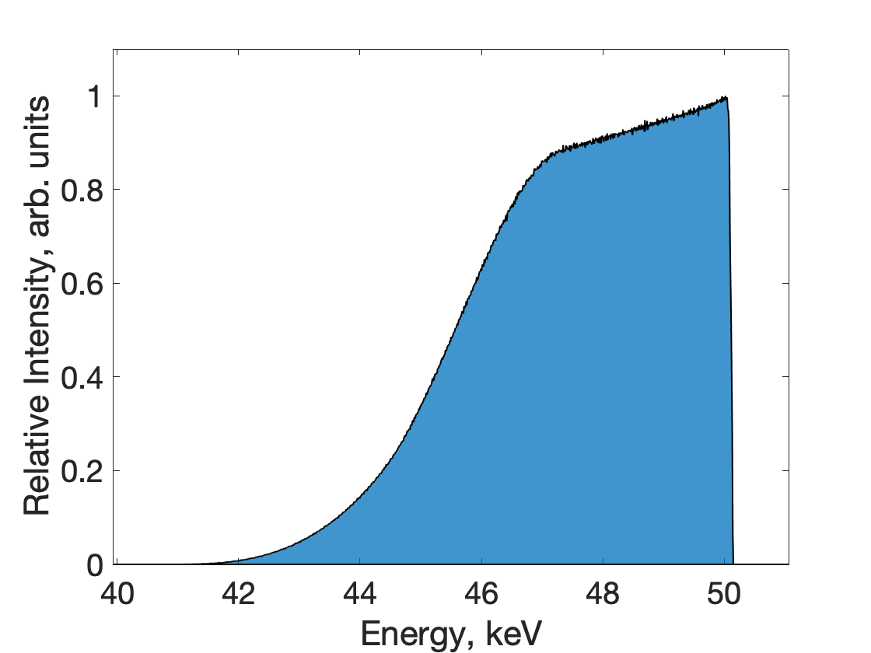
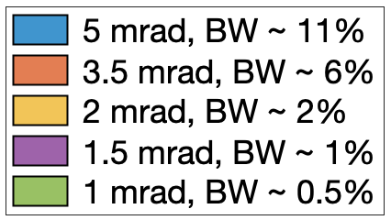
Laser-Compton Source
Double Doppler upshift
$$\frac{dN}{dΩdω}=∫\frac{dσ}{dΩ}δ\left(ω−ω_{l}\frac{κ_{l}}{κ}\right)\left(1+β_{0}\right)n_{l}(x_{μ})n_{e}(x_{μ})d^{4}x_{μ}$$
$$E_{γ}=\frac{4γ^{2}}{1+γ^{2}θ^{2}+4γk_{0}λ_{c}}E_{L}$$
Angle correlated spectrum
Laser beam properties
Electron beam properties
Klein-Nishina
Reutershan T, Effarah HH, Lagzda A, Barty CPJ. Applied Optics (2022) 61(6):C162:178

Slide 16
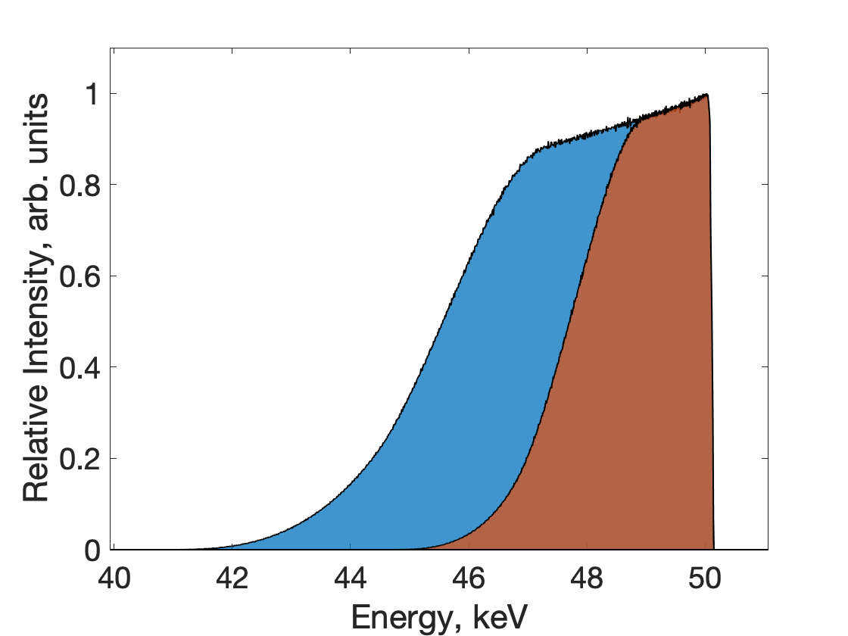
Laser-Compton Source
Double Doppler upshift
$$\frac{dN}{dΩdω}=∫\frac{dσ}{dΩ}δ\left(ω−ω_{l}\frac{κ_{l}}{κ}\right)\left(1+β_{0}\right)n_{l}(x_{μ})n_{e}(x_{μ})d^{4}x_{μ}$$
$$E_{γ}=\frac{4γ^{2}}{1+γ^{2}θ^{2}+4γk_{0}λ_{c}}E_{L}$$
Angle correlated spectrum
Laser beam properties
Electron beam properties
Klein-Nishina
Reutershan T, Effarah HH, Lagzda A, Barty CPJ. Applied Optics (2022) 61(6):C162:178

Slide 17
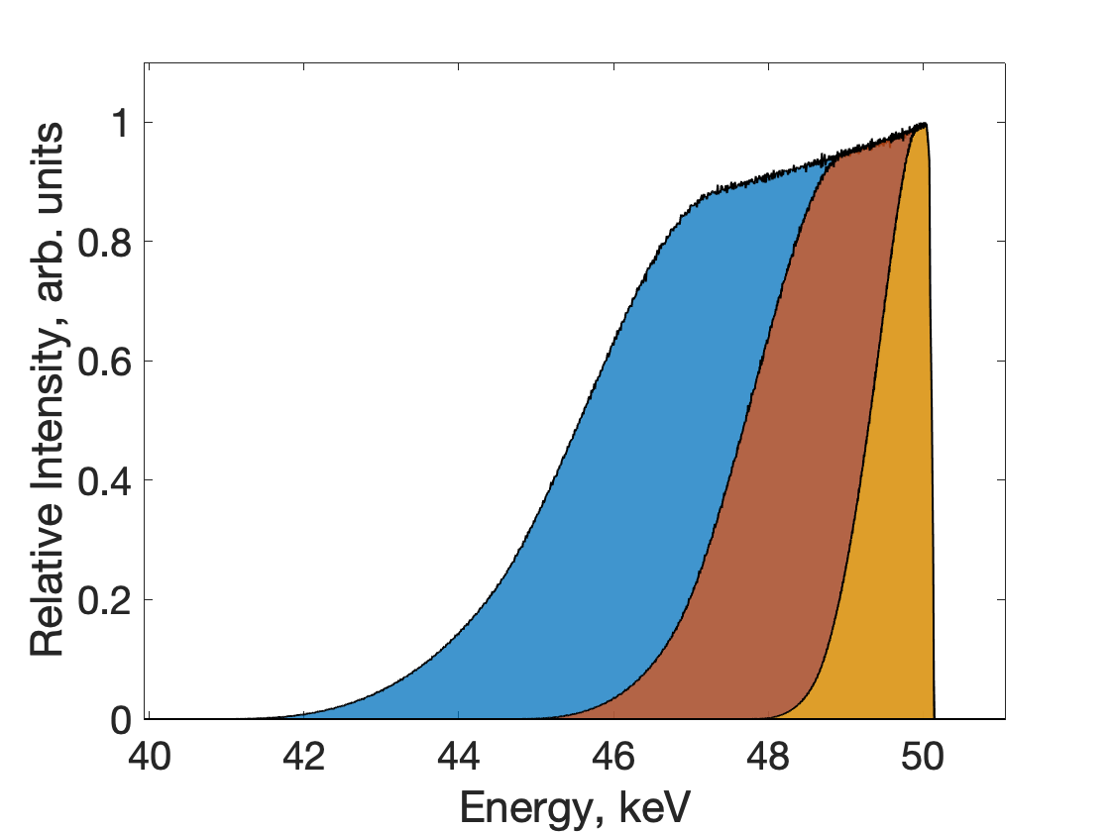
Laser-Compton Source
Double Doppler upshift
$$\frac{dN}{dΩdω}=∫\frac{dσ}{dΩ}δ\left(ω−ω_{l}\frac{κ_{l}}{κ}\right)\left(1+β_{0}\right)n_{l}(x_{μ})n_{e}(x_{μ})d^{4}x_{μ}$$
$$E_{γ}=\frac{4γ^{2}}{1+γ^{2}θ^{2}+4γk_{0}λ_{c}}E_{L}$$
Angle correlated spectrum
Laser beam properties
Electron beam properties
Klein-Nishina
Reutershan T, Effarah HH, Lagzda A, Barty CPJ. Applied Optics (2022) 61(6):C162:178

Slide 18
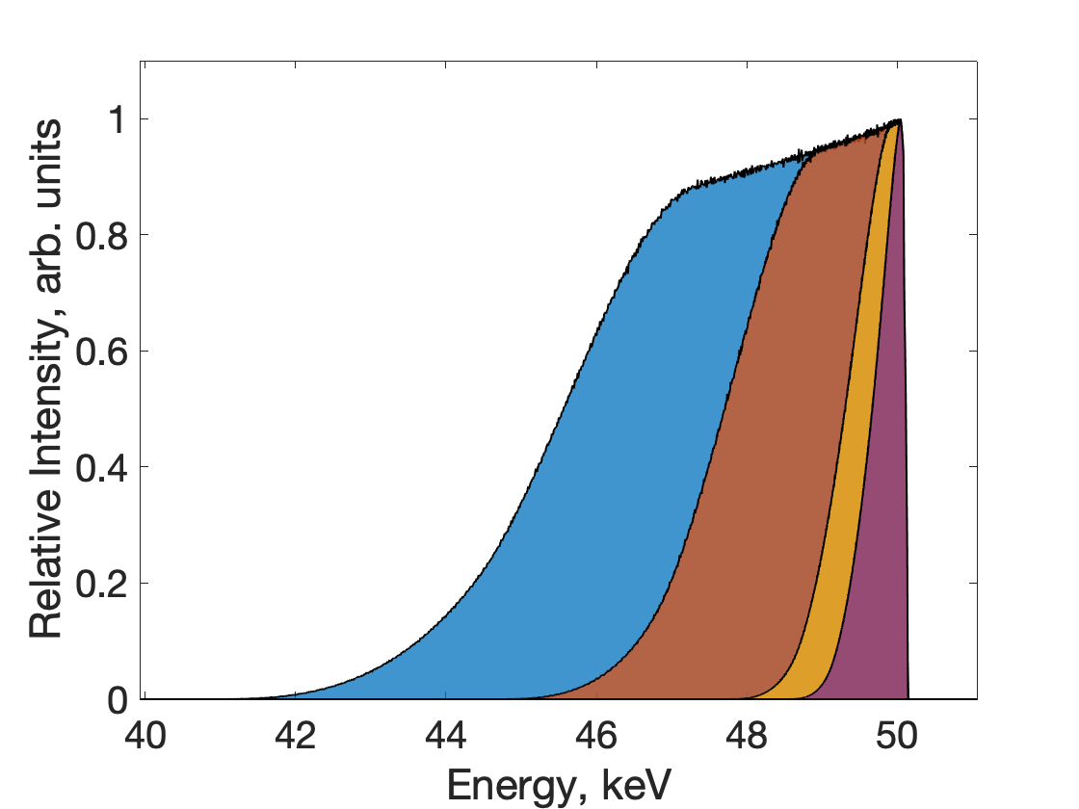
Laser-Compton Source
Double Doppler upshift
$$\frac{dN}{dΩdω}=∫\frac{dσ}{dΩ}δ\left(ω−ω_{l}\frac{κ_{l}}{κ}\right)\left(1+β_{0}\right)n_{l}(x_{μ})n_{e}(x_{μ})d^{4}x_{μ}$$
$$E_{γ}=\frac{4γ^{2}}{1+γ^{2}θ^{2}+4γk_{0}λ_{c}}E_{L}$$
Angle correlated spectrum
Laser beam properties
Electron beam properties
Klein-Nishina
Reutershan T, Effarah HH, Lagzda A, Barty CPJ. Applied Optics (2022) 61(6):C162:178

Slide 19
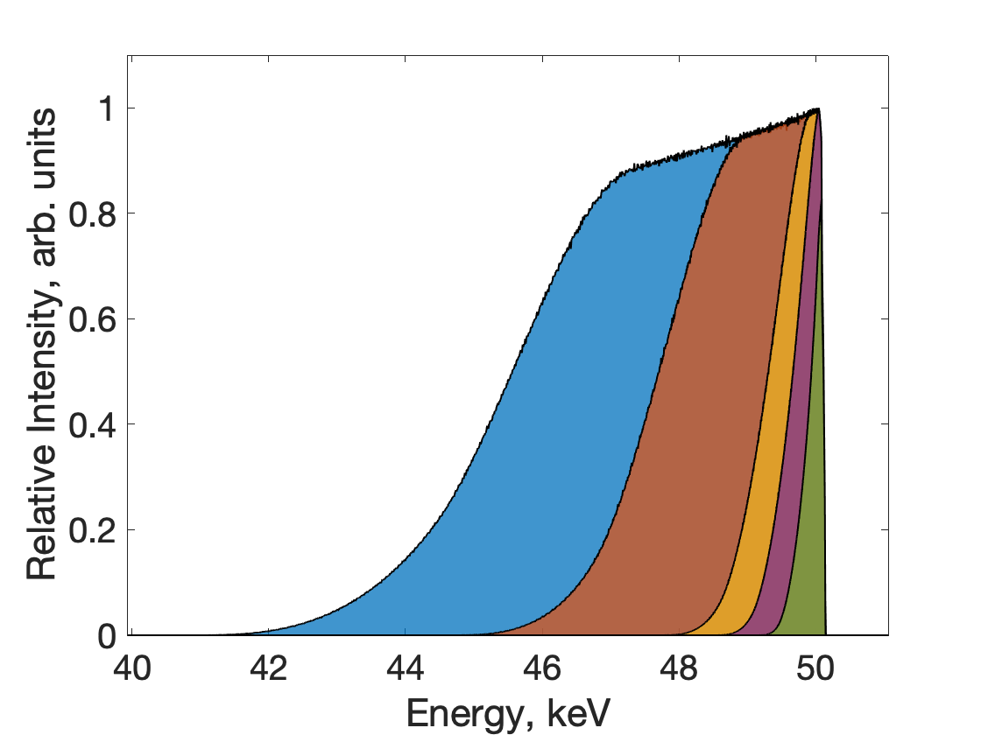
Laser-Compton Source
Double Doppler upshift
$$\frac{dN}{dΩdω}=∫\frac{dσ}{dΩ}δ\left(ω−ω_{l}\frac{κ_{l}}{κ}\right)\left(1+β_{0}\right)n_{l}(x_{μ})n_{e}(x_{μ})d^{4}x_{μ}$$
$$E_{γ}=\frac{4γ^{2}}{1+γ^{2}θ^{2}+4γk_{0}λ_{c}}E_{L}$$
Angle correlated spectrum
Laser beam properties
Electron beam properties
Klein-Nishina
Reutershan T, Effarah HH, Lagzda A, Barty CPJ. Applied Optics (2022) 61(6):C162:178

Slide 20
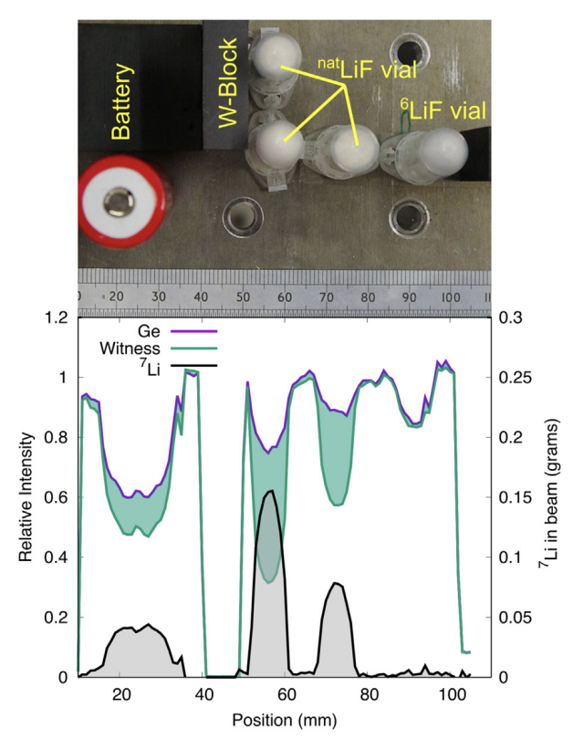
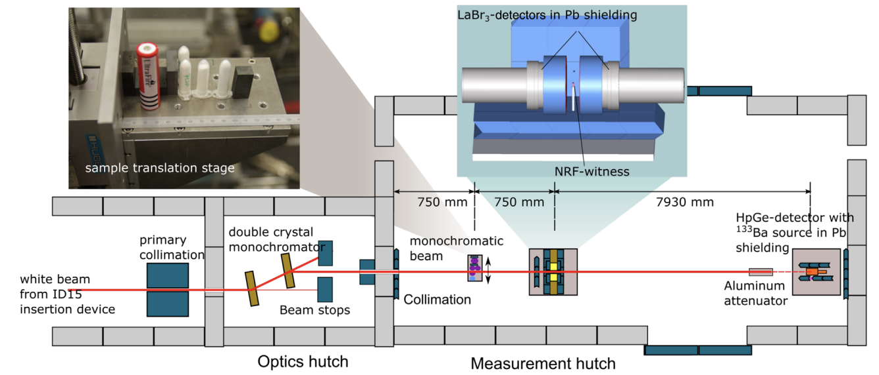
1D Imaging has been Demonstrated
Experiment performed at ESRF with a 10⁻³ bandwidth source.
Jentschel M, Albert F, Buslaps T, Friman-Gayer U, Honkimaki V, Mertes L, Pollit AJ, Mutti P, Pietralla N, Barty CPJ. Applied Optics. Vol 61, No 6 (2022), C125-C132.

Slide 21
Computational Demonstration of 2D Li-7 Imaging

Slide 22
Computational Demonstration of 2D Li-7 Imaging
e⁻ beam: GPT

Slide 23
Computational Demonstration of 2D Li-7 Imaging
e⁻ beam: GPT
e⁻ bunch / laser pulse interaction: Mathematica
This method retains the spatial-energy x-ray spectrum required for accurate simulation.

Slide 24
Computational Demonstration of 2D Li-7 Imaging
e⁻ beam: GPT
e⁻ bunch / laser pulse interaction: Mathematica
x-ray propagation through object and image generation: Matlab/Geant4 w/ G4NRF
This method retains the spatial-energy x-ray spectrum required for accurate simulation.

Slide 25
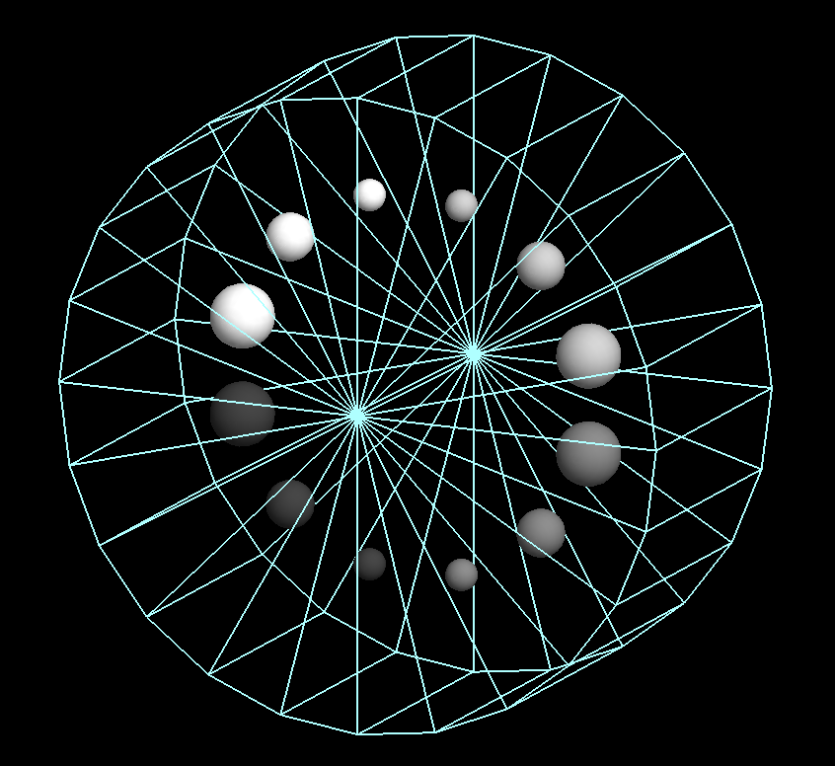
Computational Demonstration of 2D Li-7 Imaging
Computational Phantom
e⁻ beam: GPT
e⁻ bunch / laser pulse interaction: Mathematica
x-ray propagation through object and image generation: Matlab/Geant4 w/ G4NRF
4.2 cm water cylinder with Li inserts of varying concentrations.

Slide 26
Bandwidth is Important
$$\frac{ΔE}{E}=2.3×{10}^{−5}$$
$$\frac{ΔE}{E}=1.0×{10}^{−4}$$
$$\frac{ΔE}{E}=1.1×{10}^{−3}$$
Images generated using a dual-energy approach.
Contrast increases with smaller bandwidths.

Slide 27
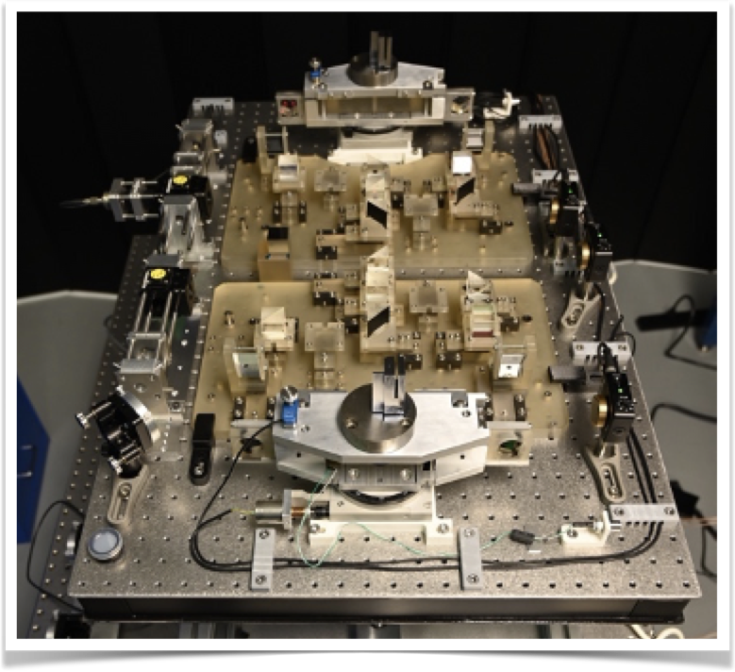
GAMS Monochromator
Speaker: Michael Jentschel
Institue Laue Langevin, Lumitron Technologies Inc.
Combination of a Diffraction Based Ultra-Narrow Band Width Filter with a Laser Compton Photon Source
Wednesday, 13 September
Junior Ballroom, 9:55 AM
Double crystal monochromator will allow further bandwidth filtering to improve contrast

Slide 28
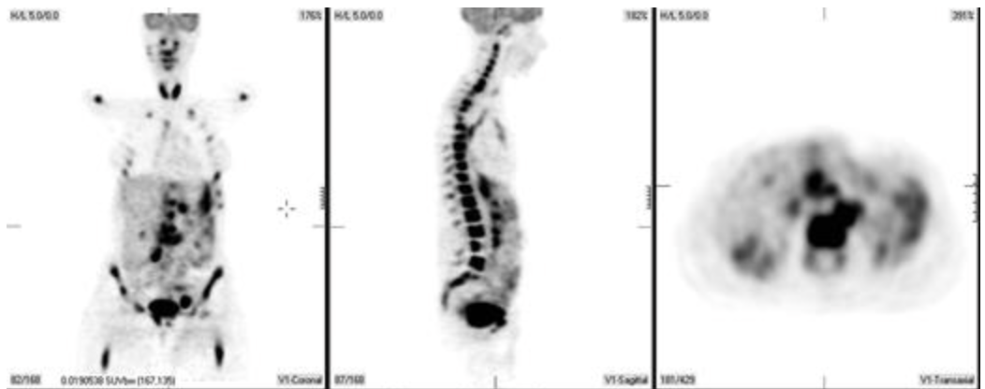
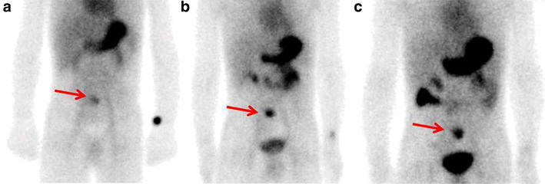
Could LCS-NRF be used for Medical Imaging?
PET
SPECT
We can learn from the PET and SPECT communities.
Seam P, et al. Blood (2007) 110 (10): 3507-3516.
Xie Q, (2016); 5(1): 1270

Slide 29
Could We Image a Clinically Used Radiotracer?
Only dipole transitions considered
National Nuclear Data Center, Brookhaven National Lab, Evaluated Nuclear Structure Data File

Slide 30
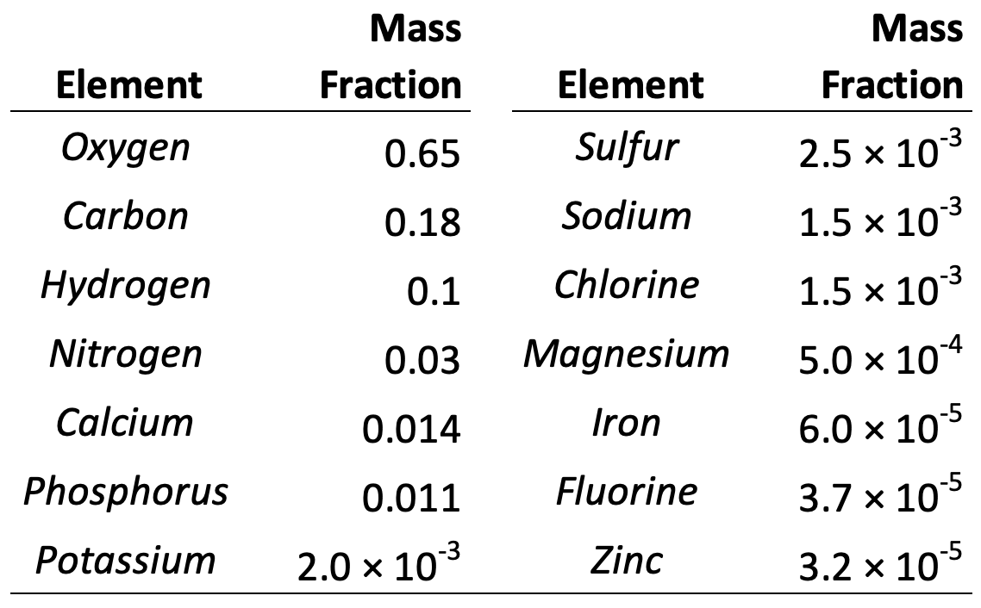
Candidate: ¹⁹F
Mass fraction of elements in human body
Not radioactive
$$Iσ=414.5\text{eV} \text{b}$$
100% abundance
Background mass fraction < $2×{10}^{−6}$
Only 5% of total fluorine is in soft tissue.
National Nuclear Data Center, Brookhaven National Lab, Evaluated Nuclear Structure Data File

Slide 31
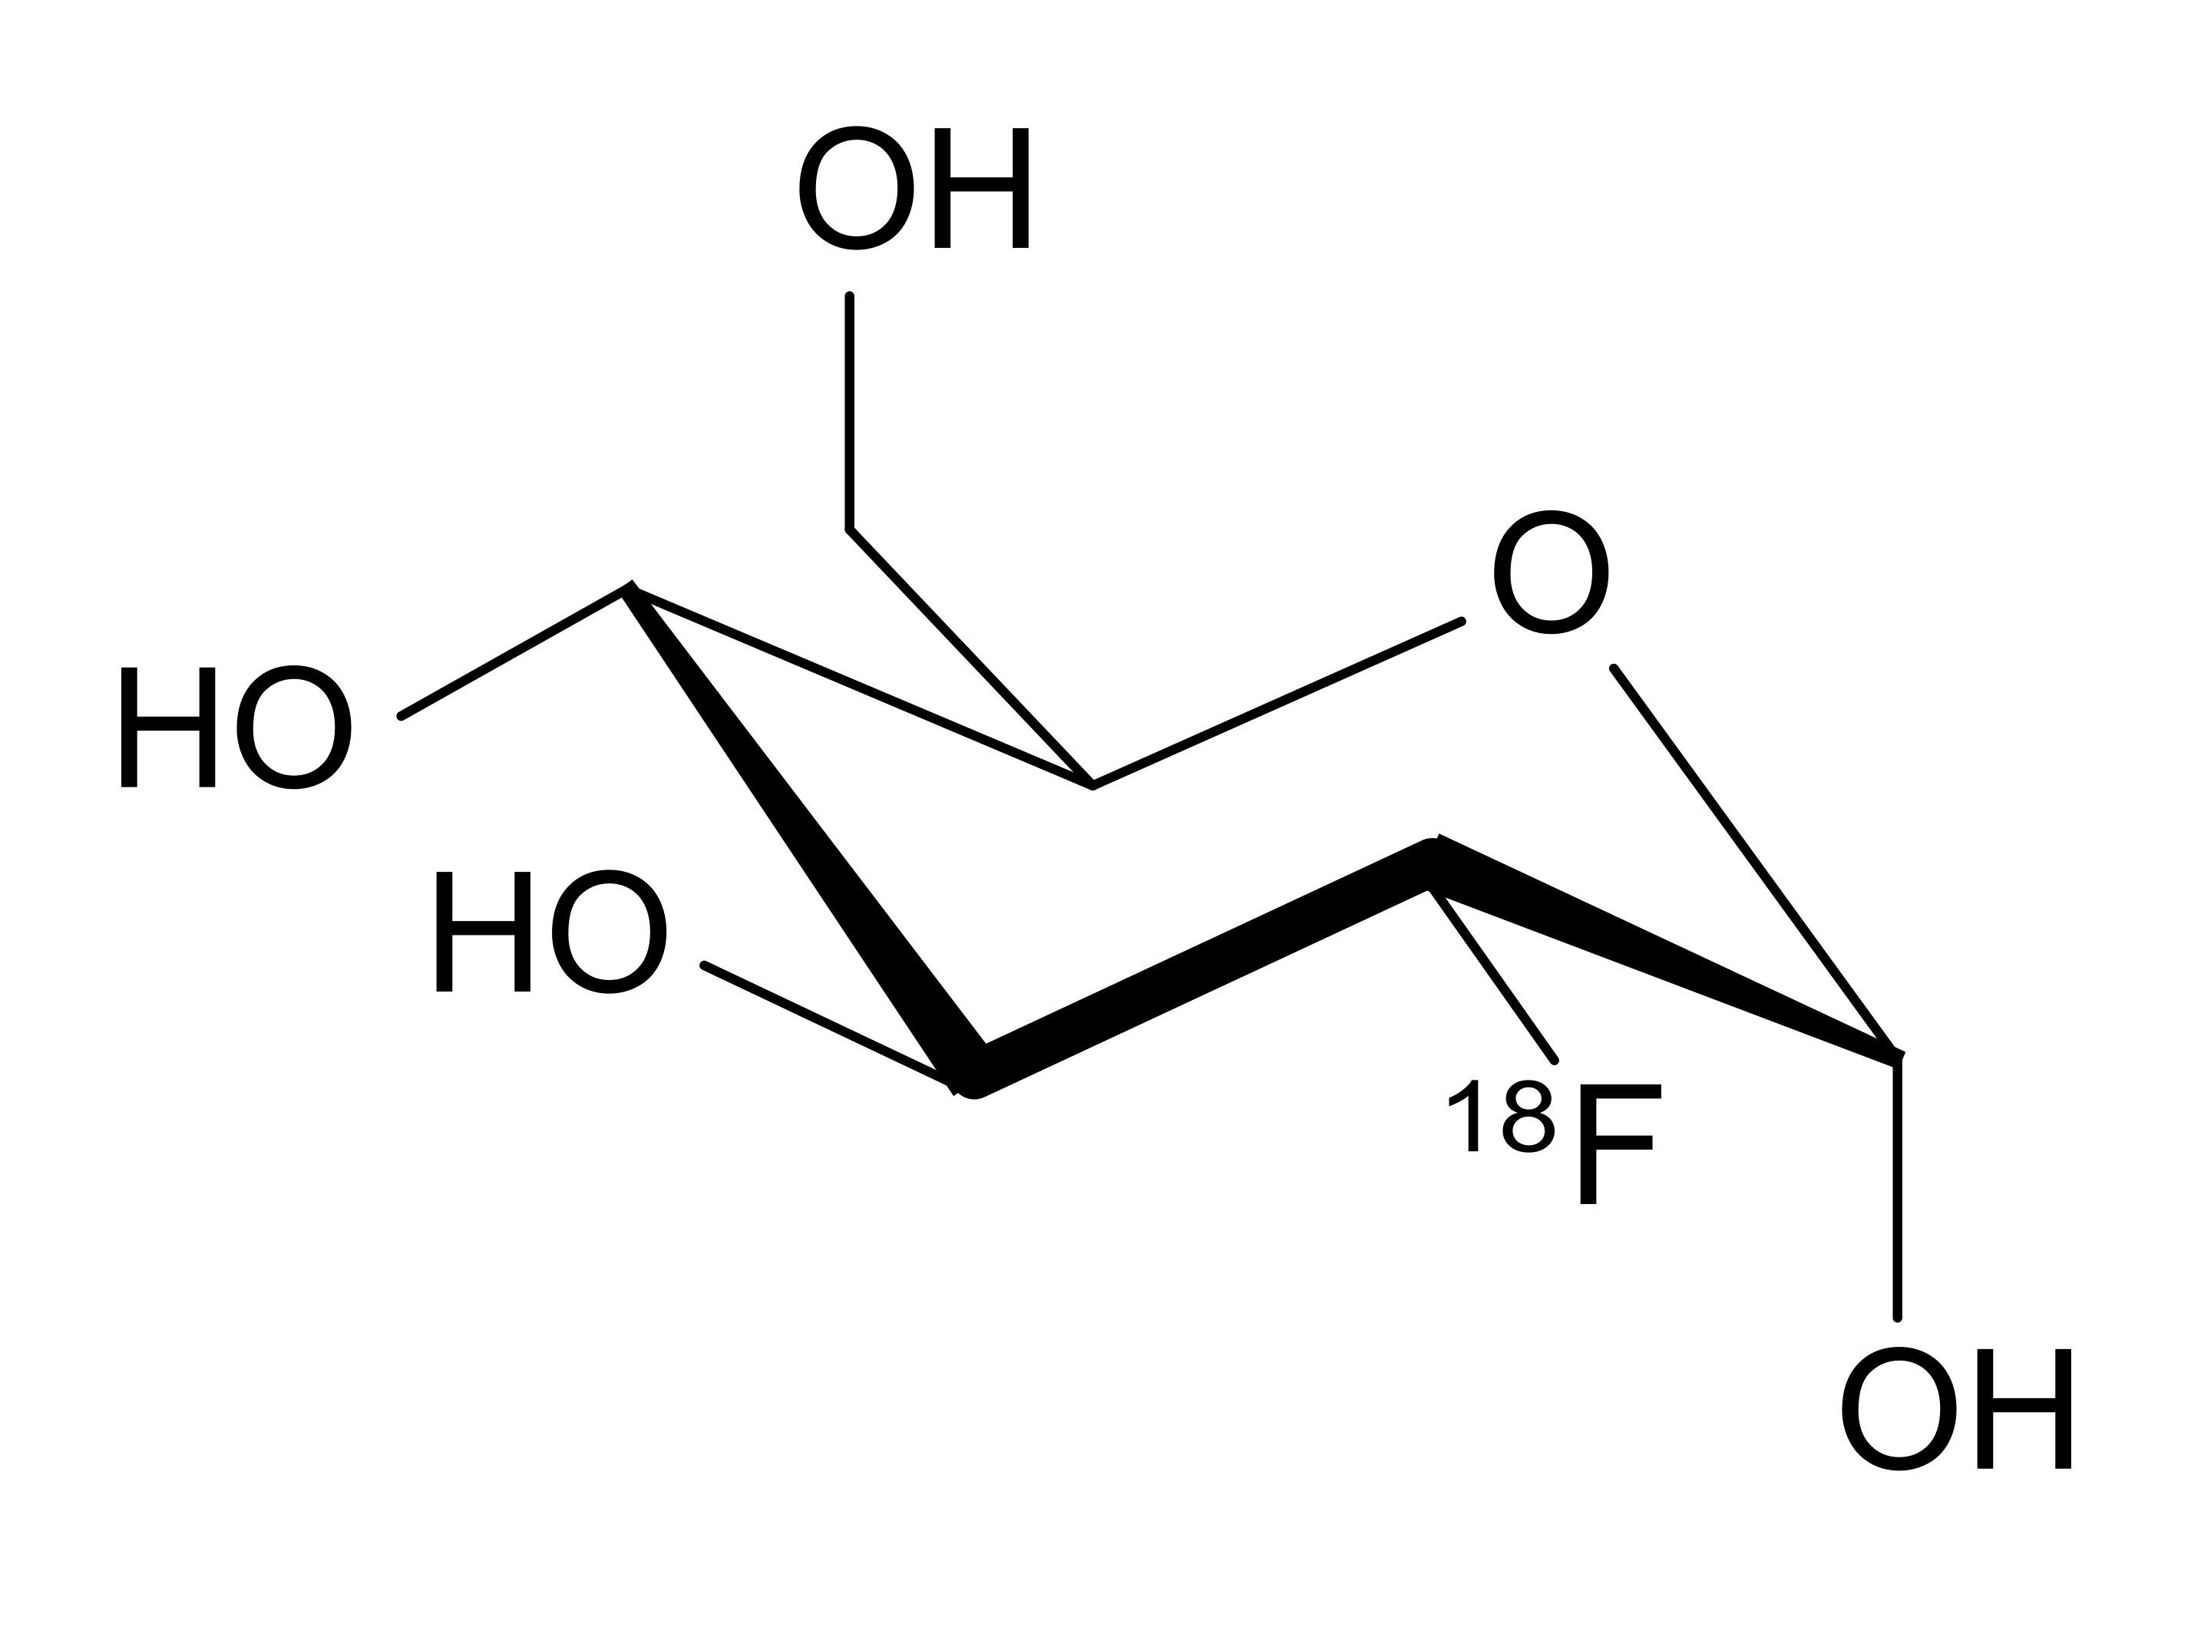
Candidate ¹⁹F
Glucose
(Sugar)
Glucose is the common molecule used for cancer PET imaging

Slide 32
Candidate ¹⁹F
Glucose
(Sugar)
18-Fluorodeoxyglucose
(PET)
$$t_{1/2}=110\text{min}$$
Substituting a hydroxyl group with a positron emitter

Slide 33
Candidate ¹⁹F
Glucose
(Sugar)
18-Fluorodeoxyglucose
(PET)
19-Fluorodeoxyglucose
(NRF - 1.5 MeV)
$$t_{1/2}=\text{stable}$$
$$t_{1/2}=110\text{min}$$
$$\text{Abundance}=100\%$$
Using NRF, we can image the same molecule, but with a stable isotope!

Slide 34
Transmission Nuclear Resonance Imaging
object
2D detector
Transmission mode gives differential tomographic reconstruction capability

Slide 35
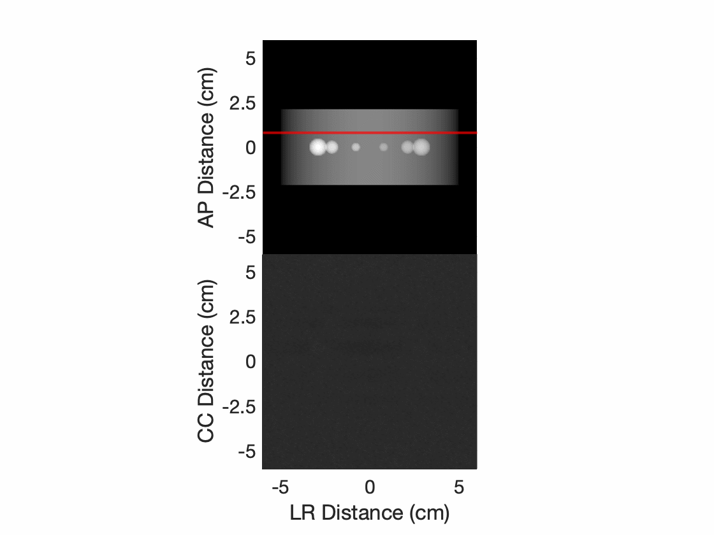
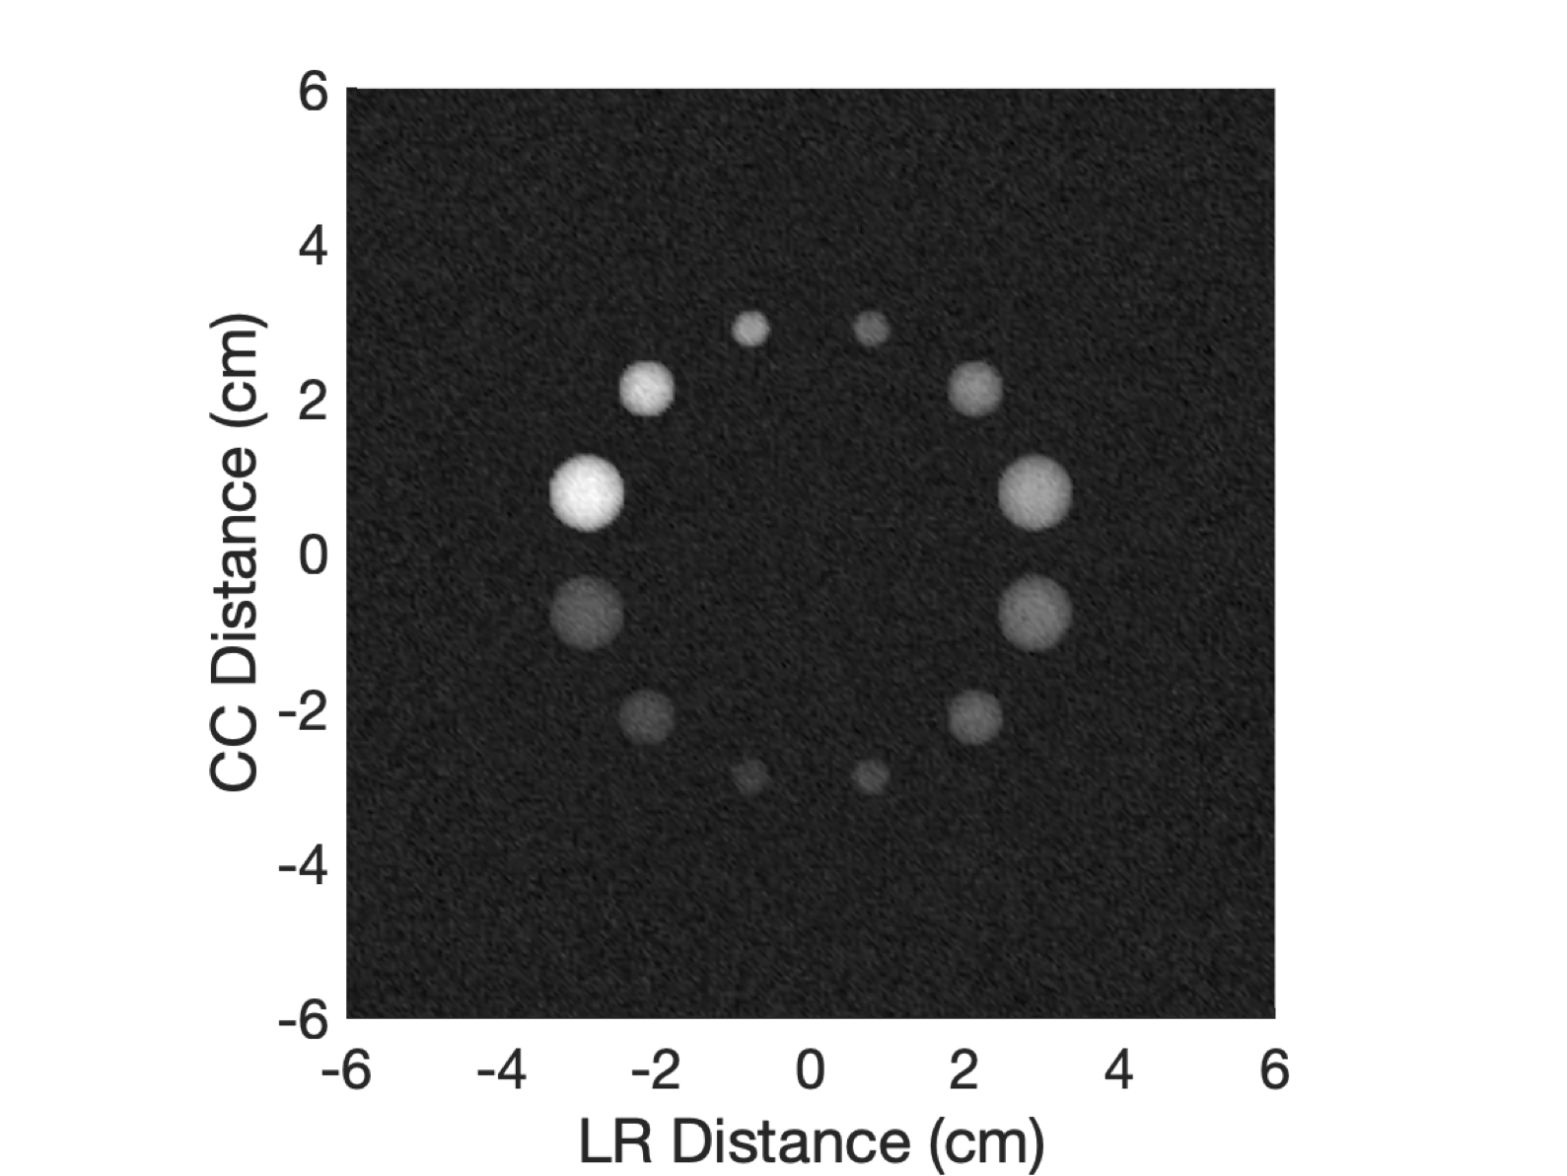
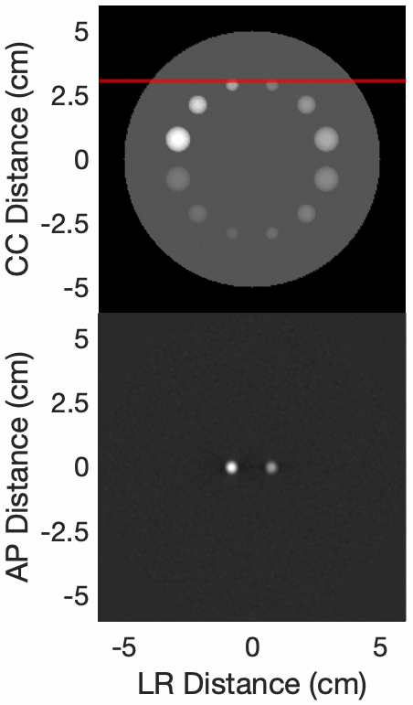
NR Transmission Image Reconstruction
2D Image
3D Reconstruction
Transmission mode gives differential tomographic reconstruction capability

Slide 36
Fluorescence Nuclear Resonance Imaging
Collimating Grid
PMT Array
Scintillator
Fluorescence mode enables 3D reconstruction without rotation

Slide 37
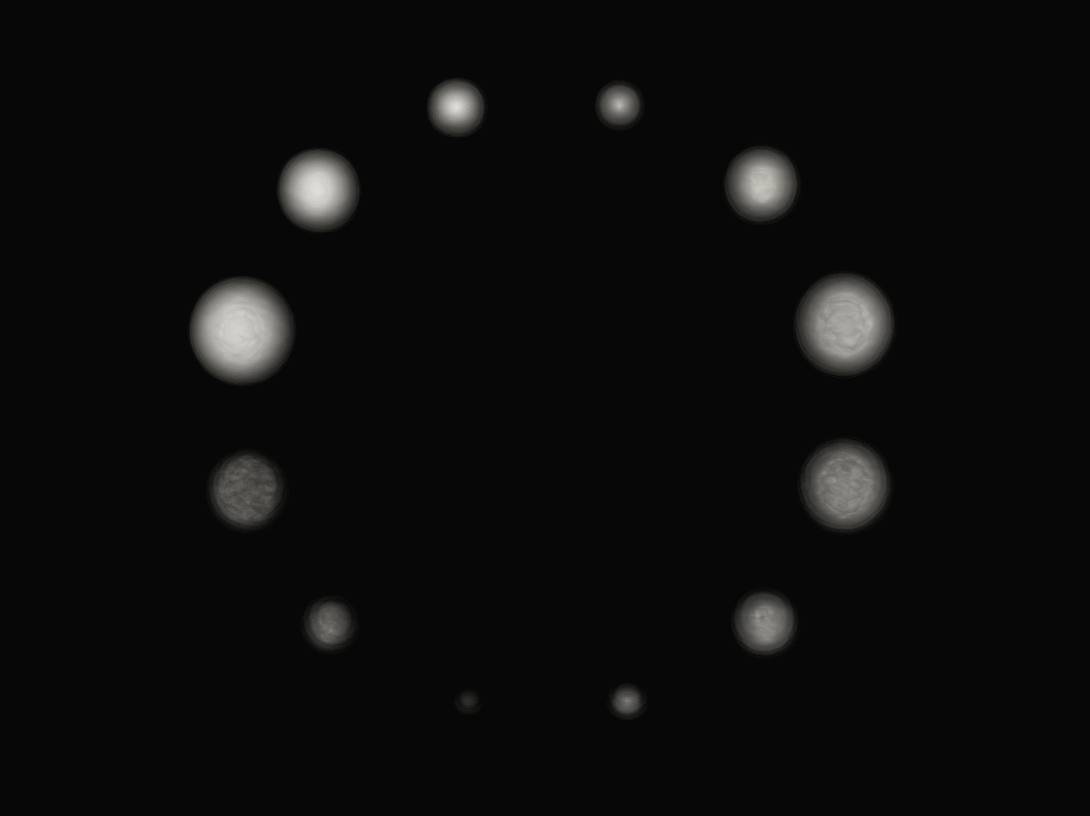
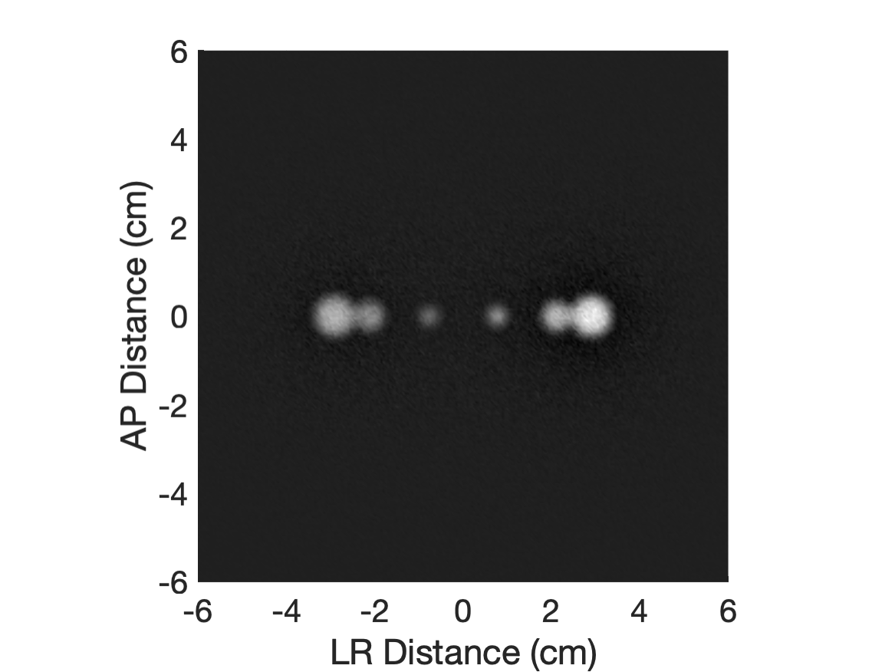
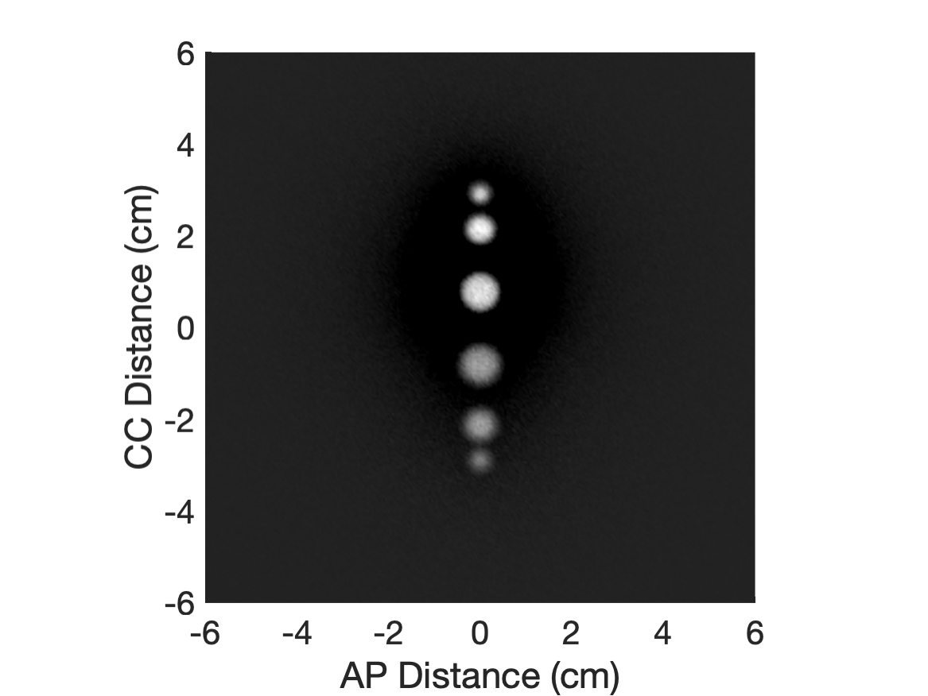
NR Fluorescence Image Reconstruction
2D Images
3D Reconstruction
Top-view
Side-view
Fluorescence mode enables 3D reconstruction without rotation

Slide 38
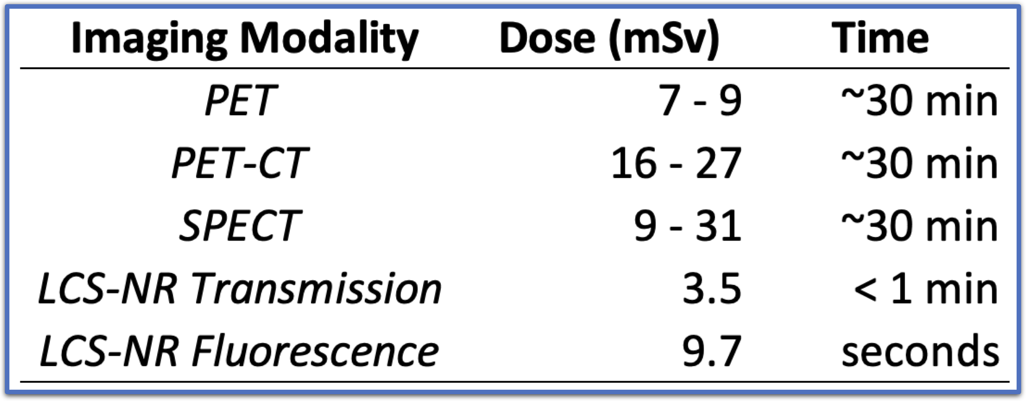
NR Fluorescence Image Reconstruction
2D Images
3D Reconstruction
Top-view detector
Side-view detector
Fluorescence mode enables 3D reconstruction without rotation
Charest M, Asselin C. Journal of Nuclear Medicine Technology. (2018) 46(2):107-113
Li Y, Jiang L, Wang H, Cai H, Xiang Y, Li L. Radiation Protection Dosimetry. (2019) 187(2):183-190

Slide 39
Conclusion
1) Demonstrated 2D and 3D LCS-NR medical imaging
2) Bandwidth is important for signal
LCS + monochromator can achieve this
3) Pool of isotopes to image
Isotope specific tags could be developed
4) Dose is comparable to similar imaging modalities

Slide 40
Acknowledgements
Research Group
Prof. CPJ Barty*
Kyle Chesnut
Michael Seggebruch
Eric Nelson
Haytham Effarah
Christine Nguyen
Dr. Michael Jentschel
Dr. Agnese Lagzda
Dr. Yoonwoo Hwang
Dr. Fred Hartemann
Dr. Ferenc Raksi

Slide 41
Thank You!
Notes:
Thank you everyone!

Slide 42
Extra Viewgraphs

Slide 43
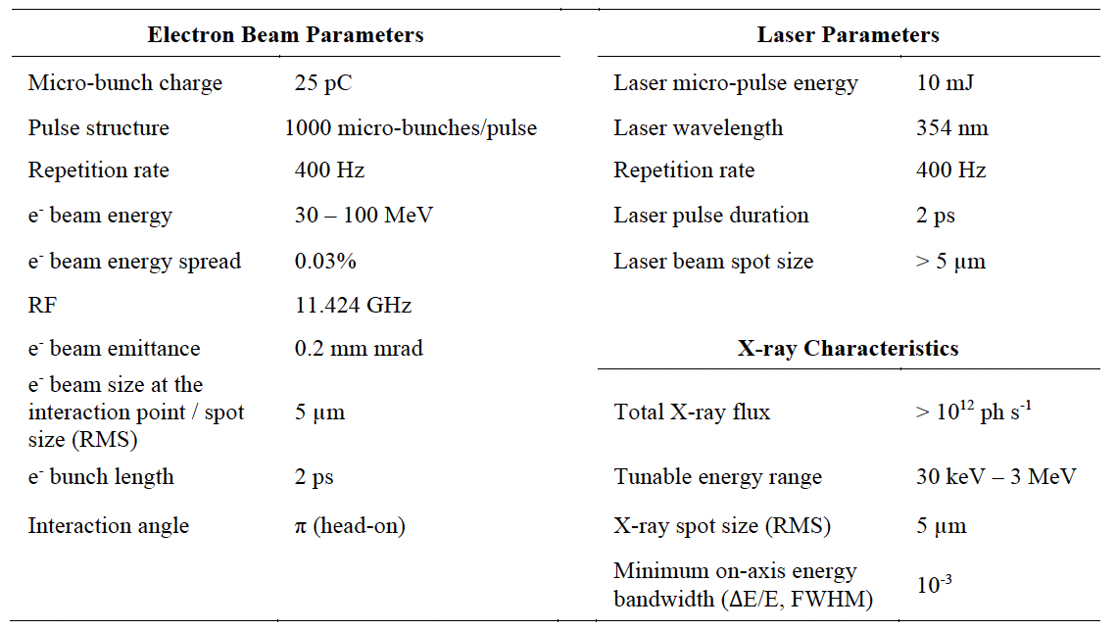
Source Parameters
Reutershan T, Effarah HH, Lagzda A, Barty CPJ. Applied Optics (2022) 61(6):C162:178

